Slide 1
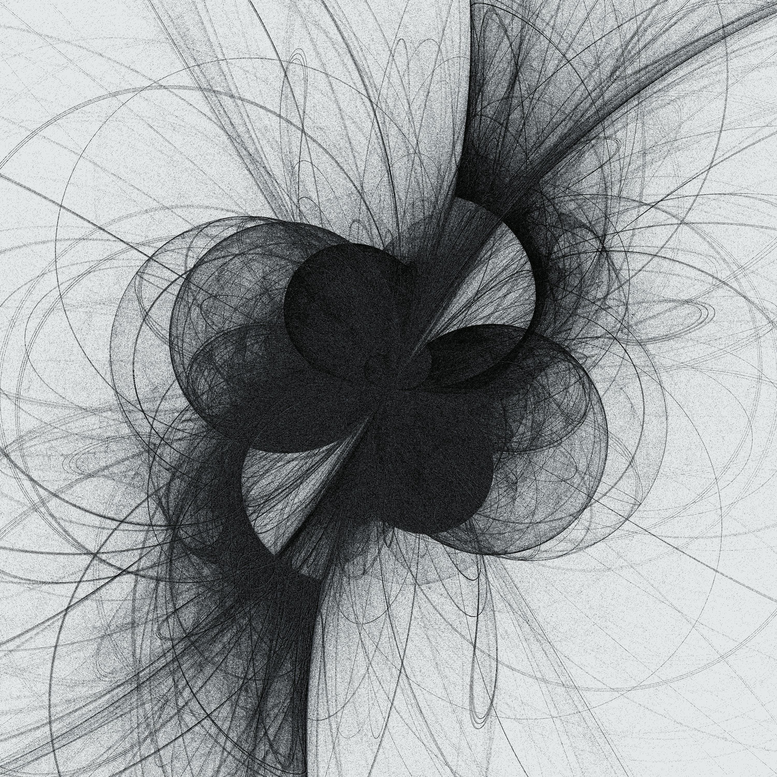
My mission to fix science A personal tale of hope, despair, and everything in between
Dr William XQ Ngiam BLRB Meeting July 5th 2023
Background art by Danielle Navarro https://art.djnavarro.net/gallery/interacting-paths/

Slide 2
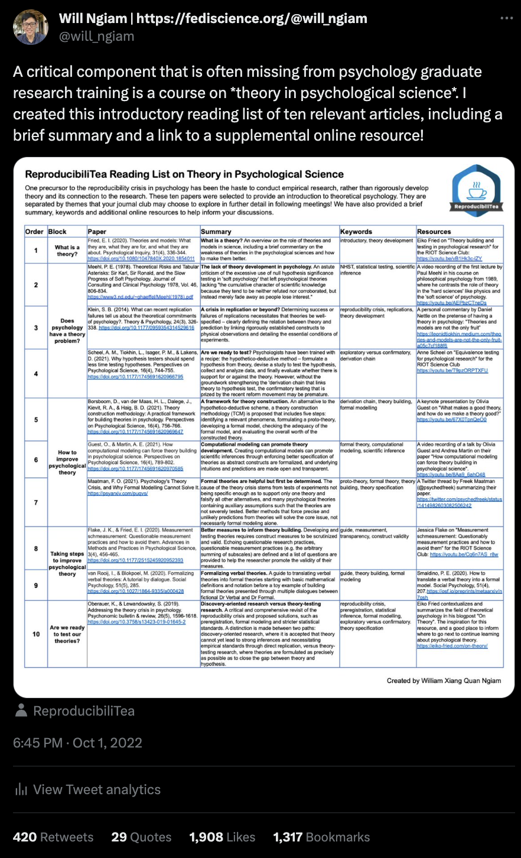
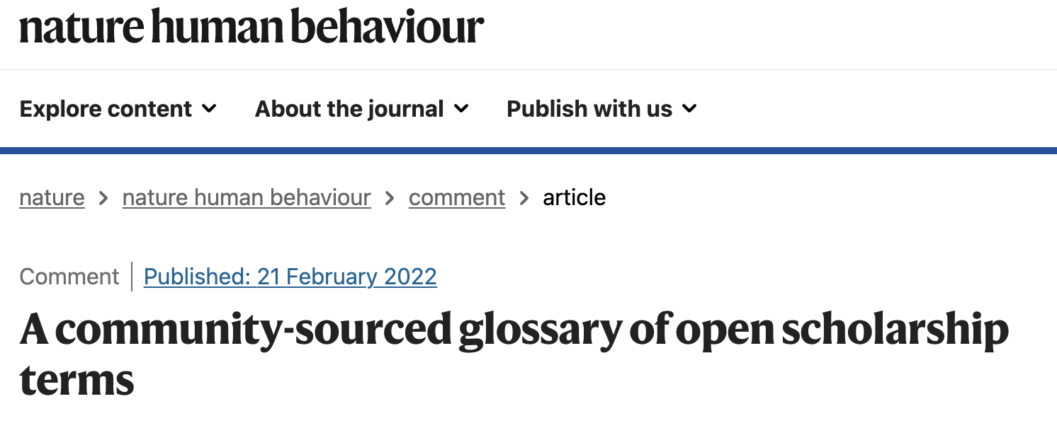
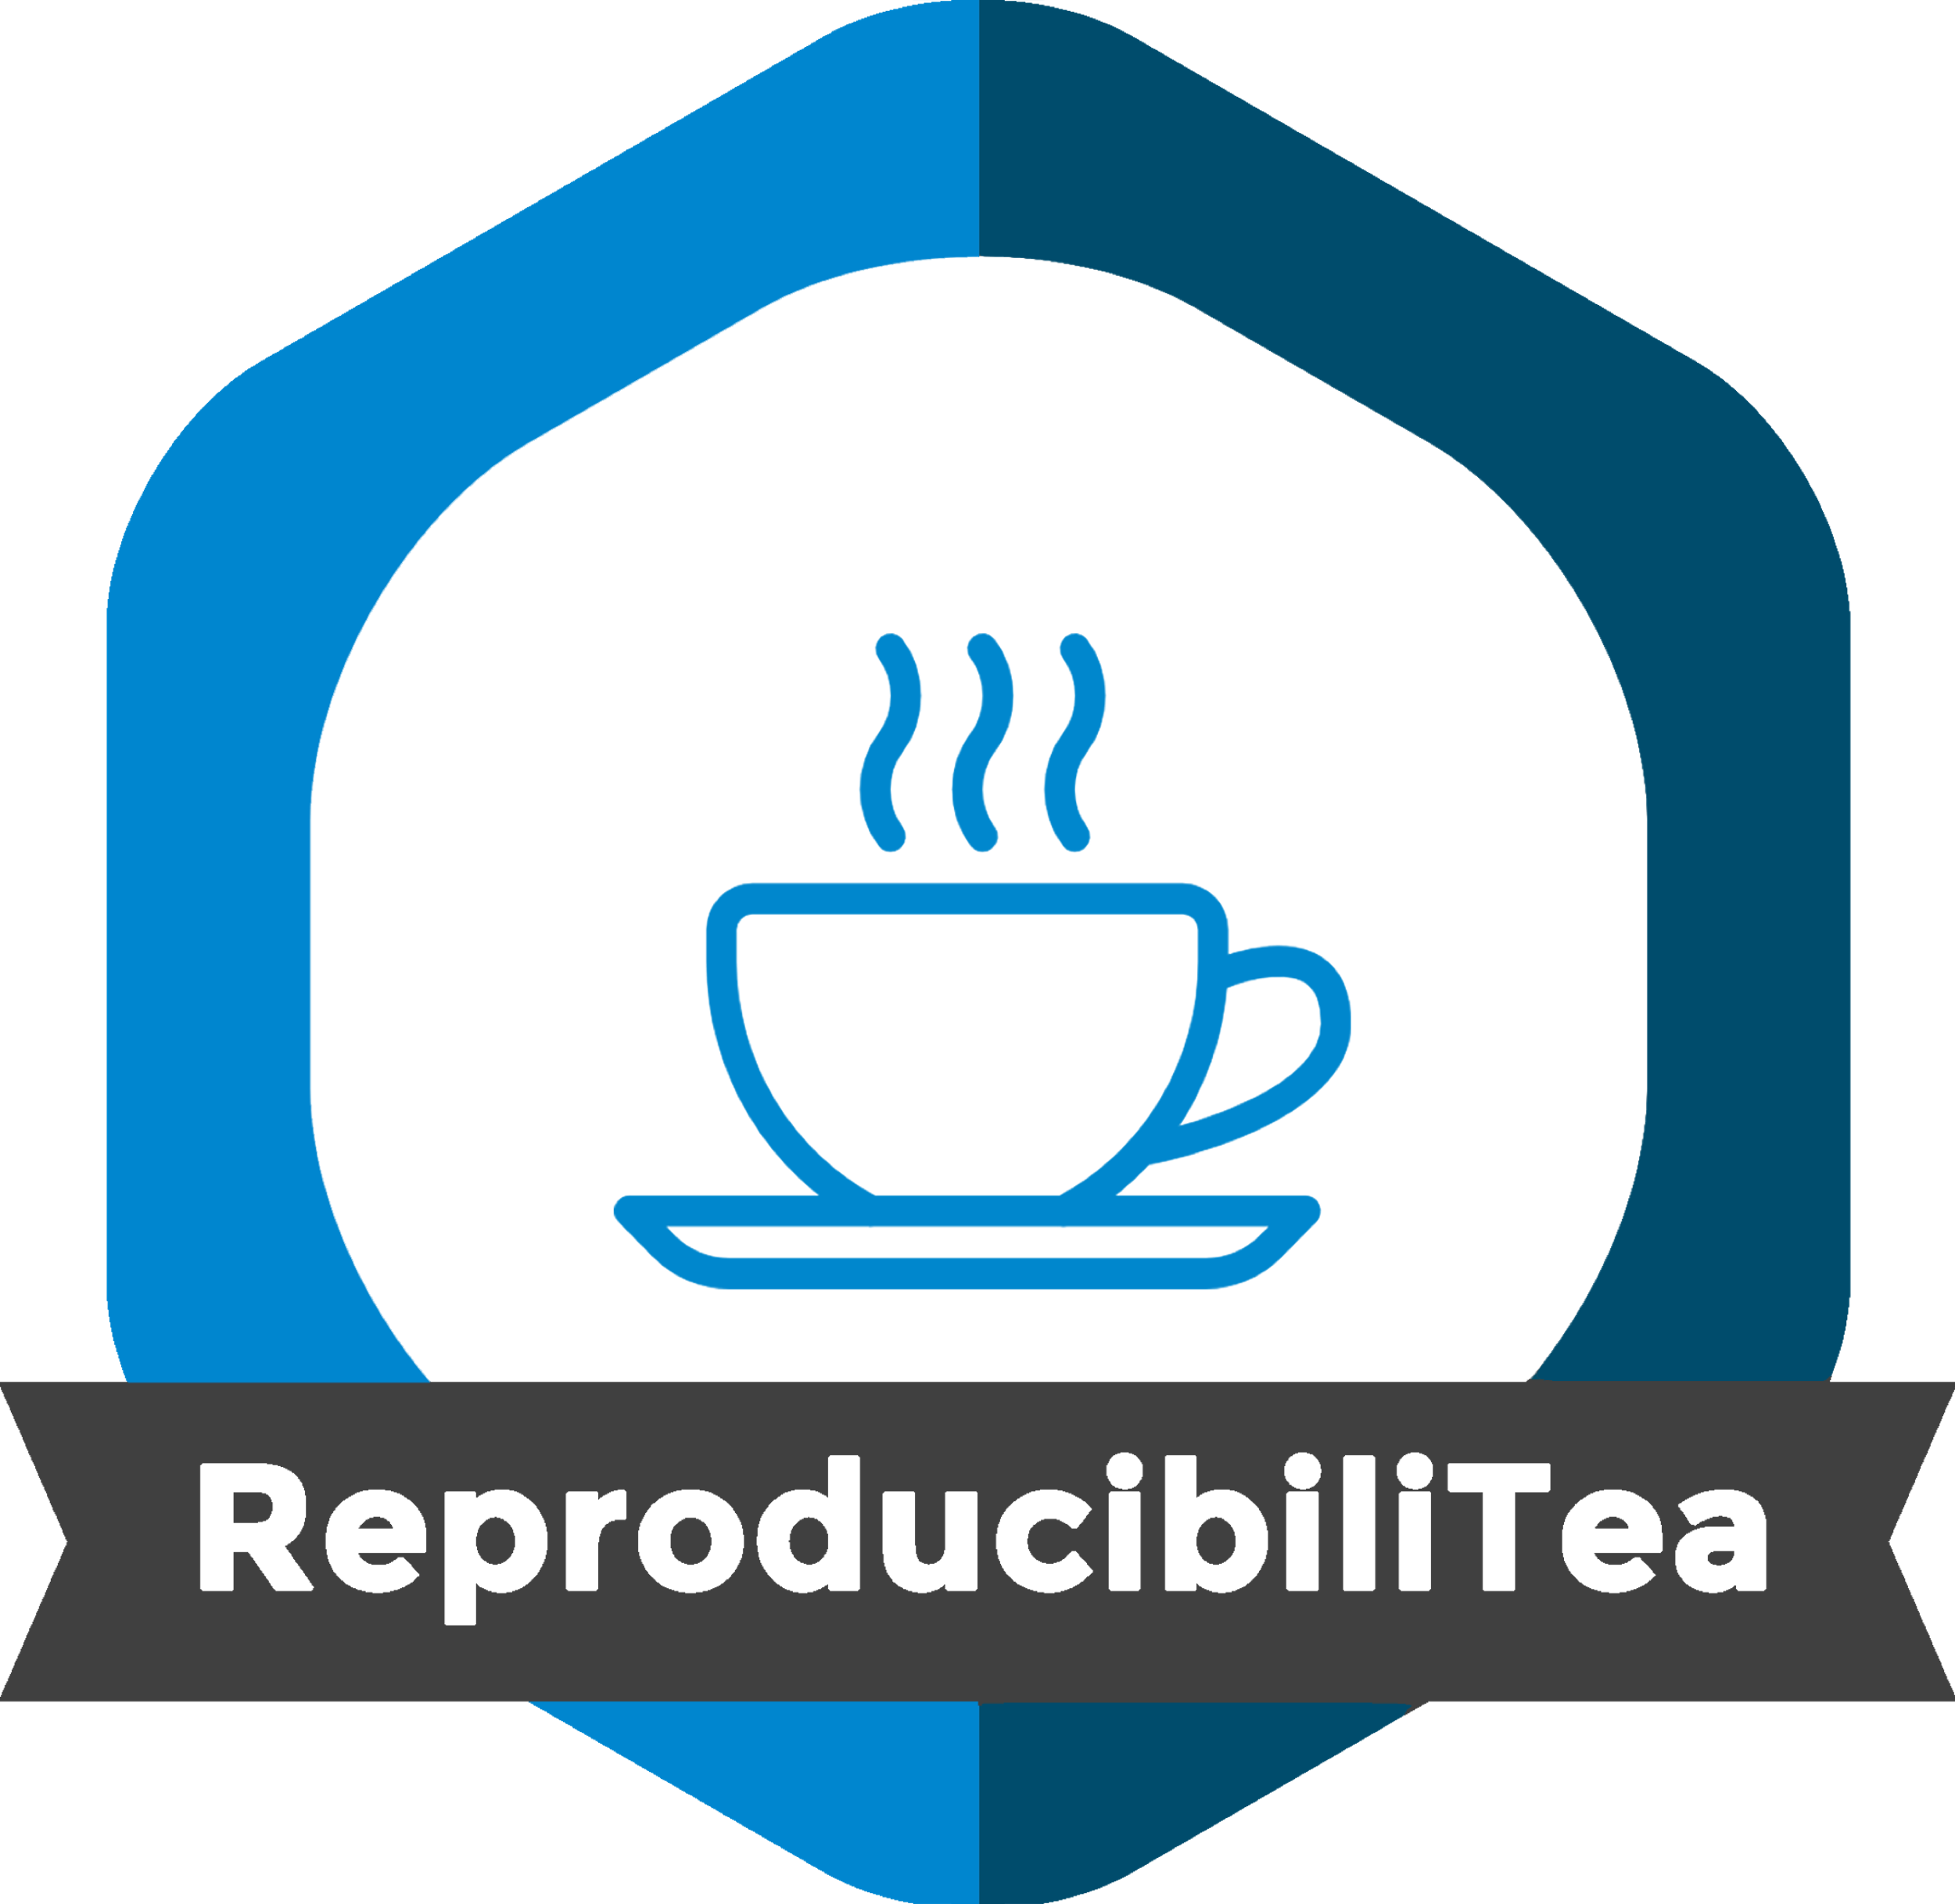

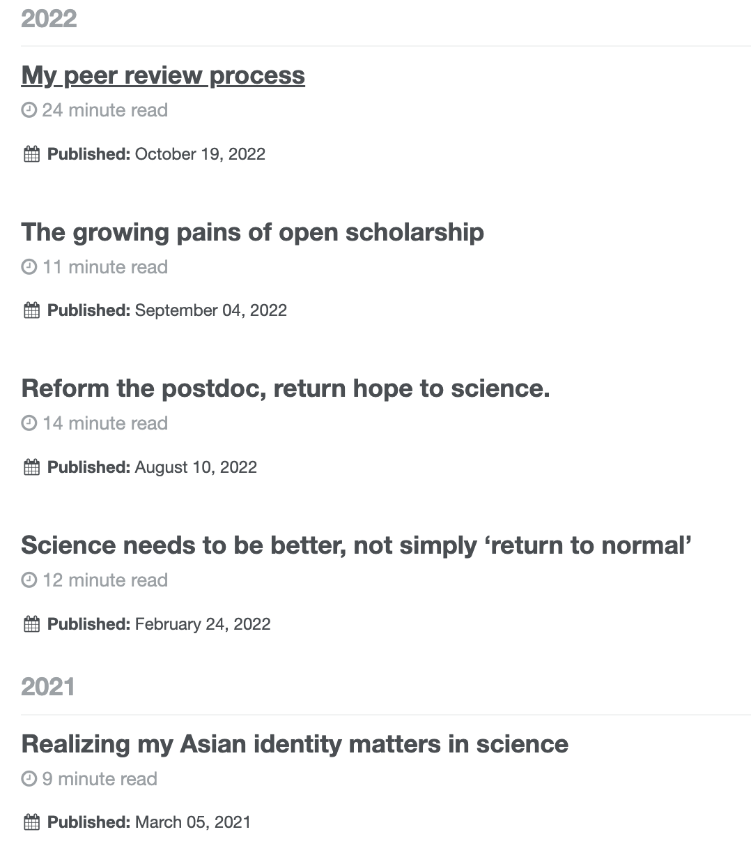
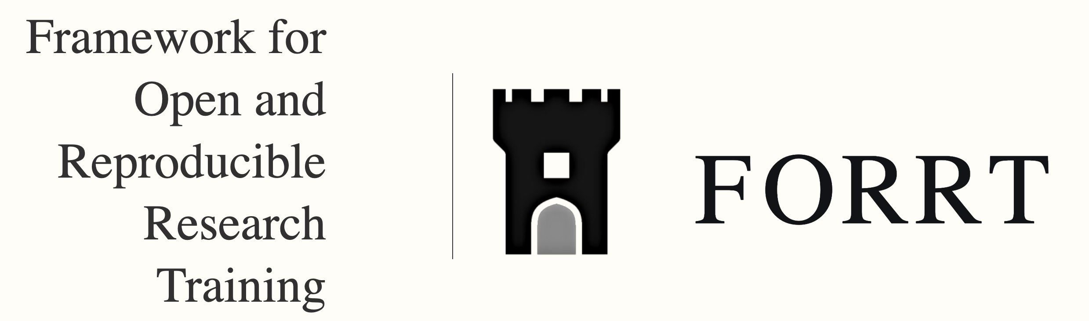
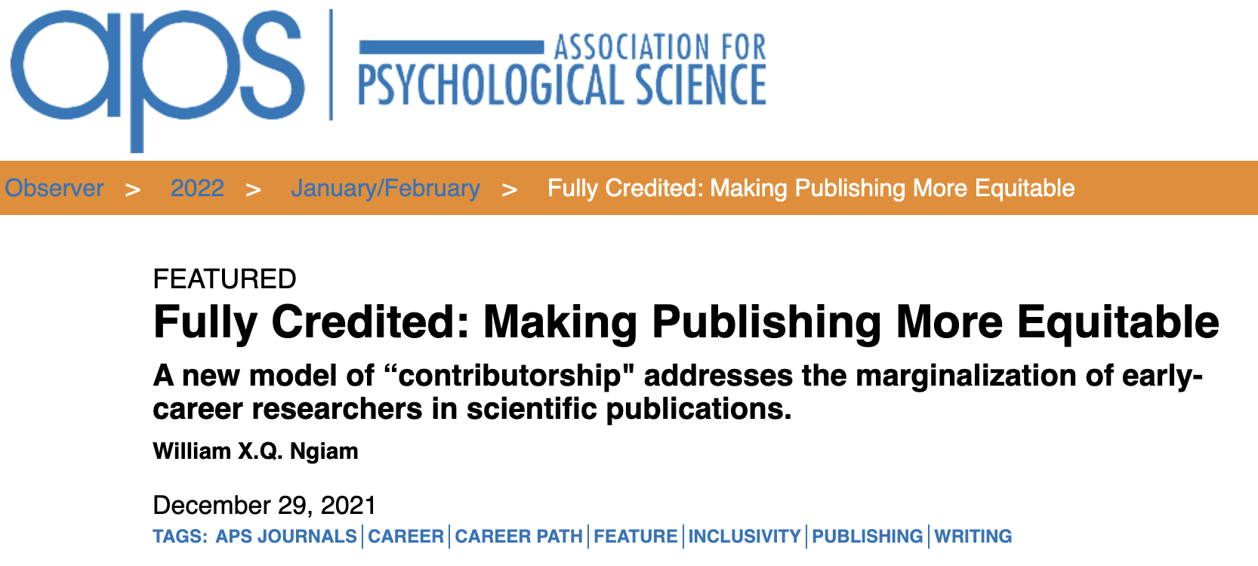
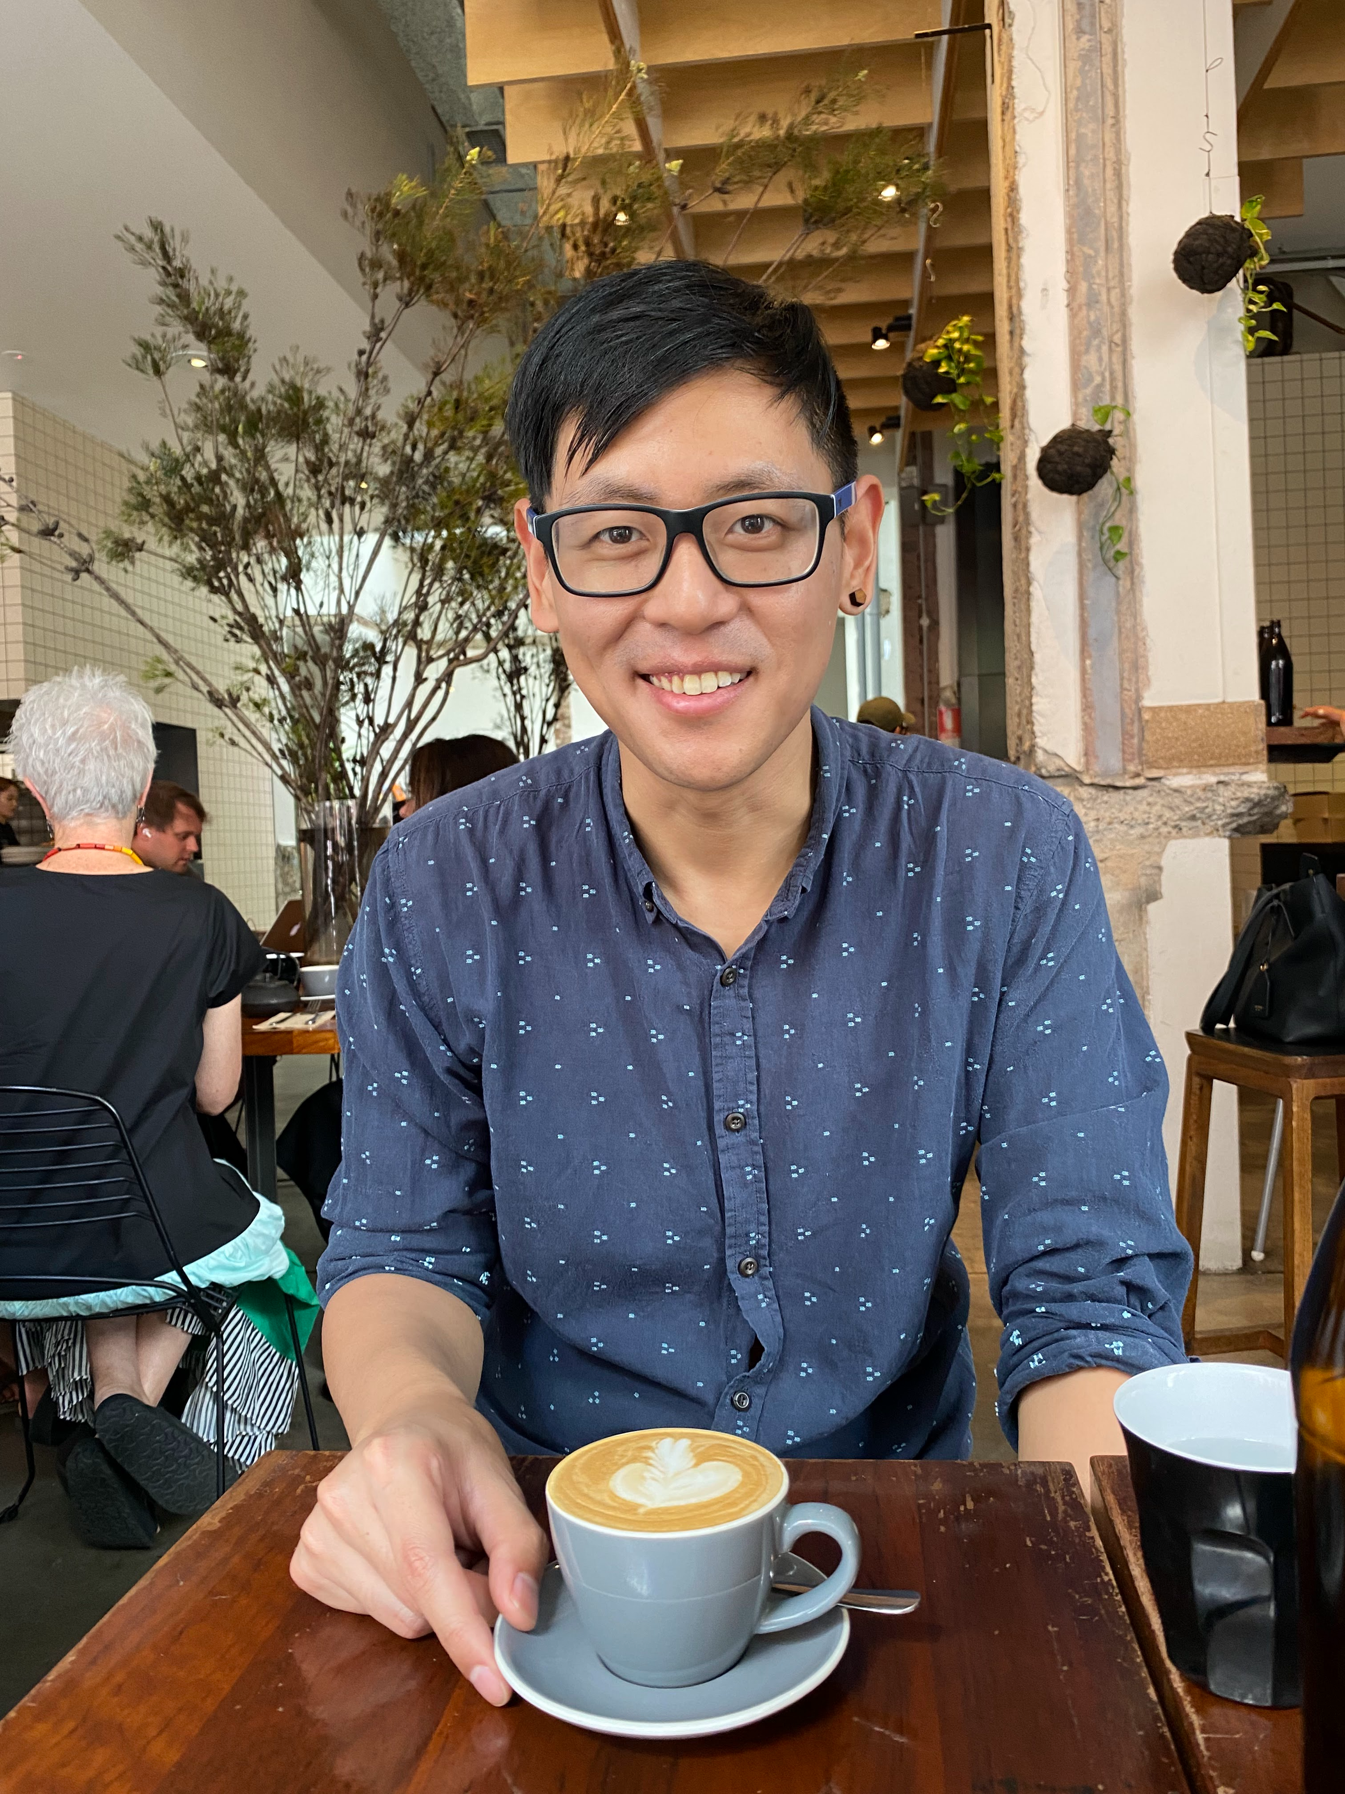
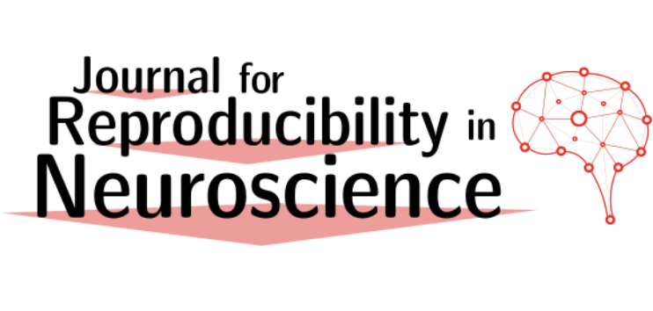
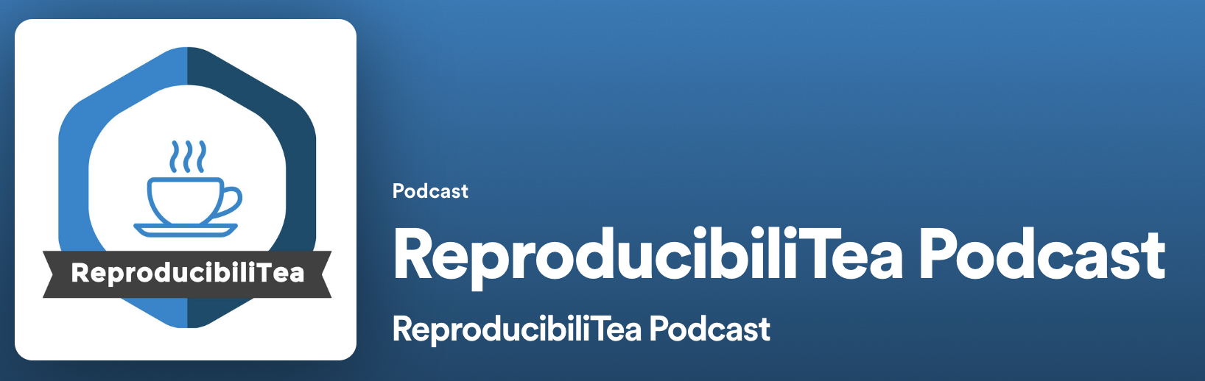
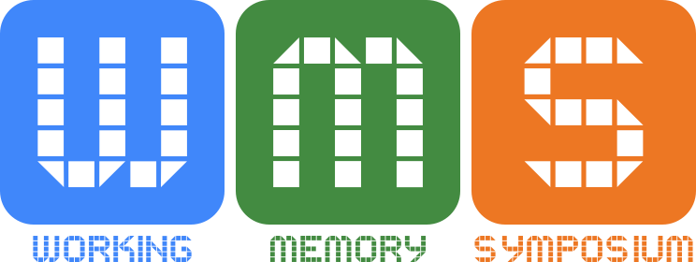
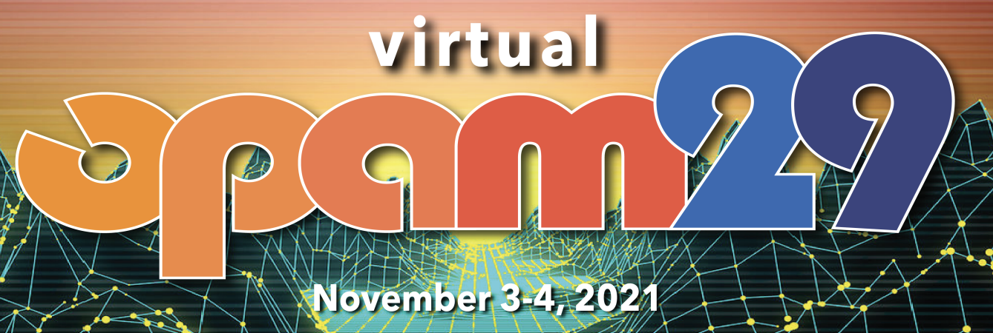
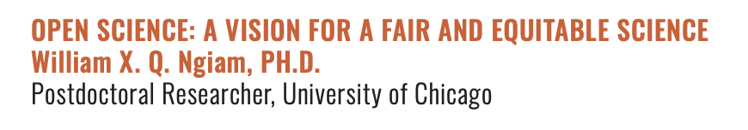

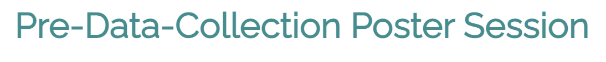
WHY?!

Slide 3
The goals of this talk
To highlight that paths in academia and science are not equal (and I think not fair)
To outline the pervasive issues in science that lead to the reproducibility crisis
To share my vision for how science and academia should be improved
To share why I think early-career researchers should be engaging in Open Science

Slide 4
My path in science and academia
Background art by Danielle Navarro https://art.djnavarro.net/gallery/interacting-paths/

Slide 5
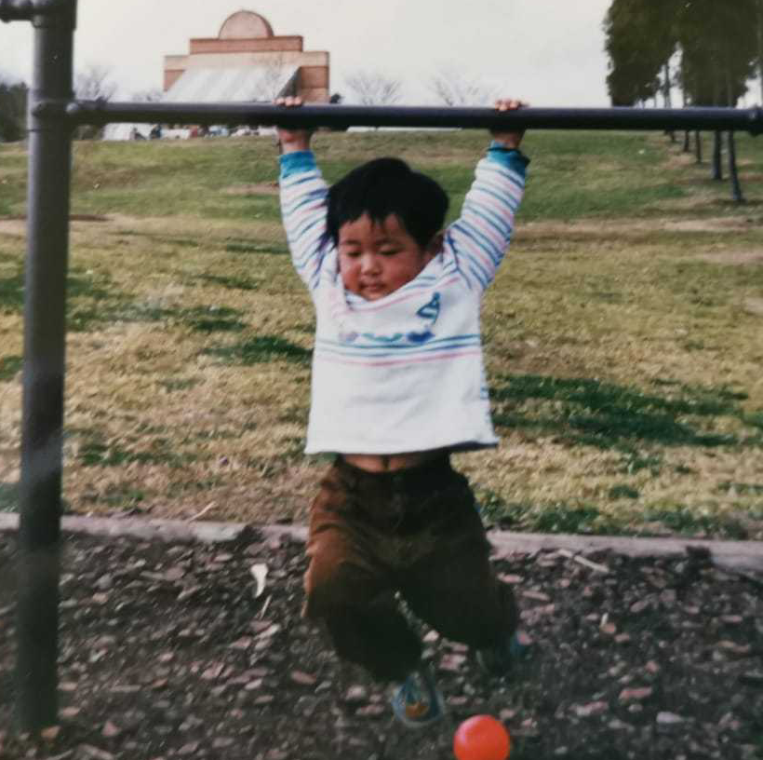
Born in Australia to Malaysian immigrants
Both parents completed secondary education
Grew up in a low-income family
Both parents were non-English speakers
Minority ethnicity
Notes:
Mum Form 3, Dad Form 5. Dad had basic English

Slide 6
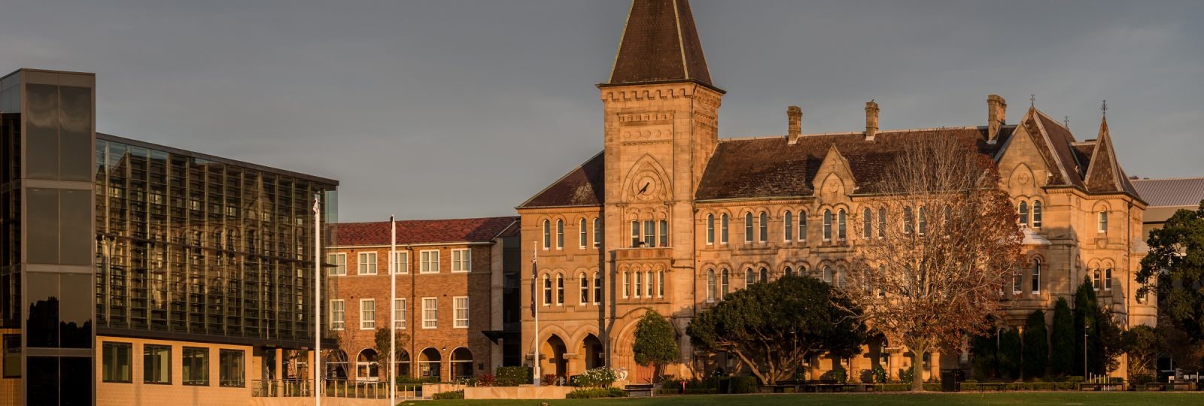
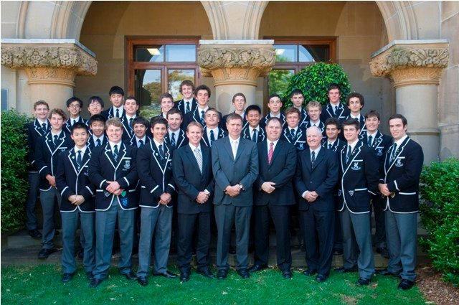
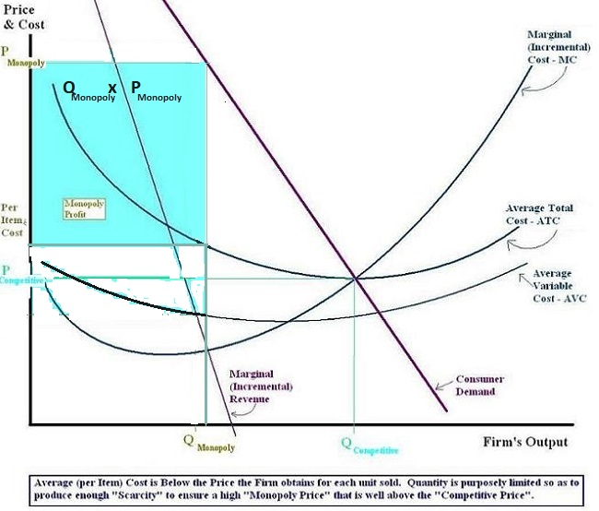
From an early age, I was pretty sensitive to unfair contexts
Photo of Newington College. Taken from https://www.newington.nsw.edu.au/ Figure of monopoly profits taken from Wikipedia. https://en.wikipedia.org/wiki/Monopoly_profit

Slide 7
“Entrepreneurship is like one of those carnival games where you throw darts or something.
Middle class kids can afford one throw. Most miss. A few hit the target and get a small prize. A very few hit the center bullseye and get a bigger prize. Rags to riches! The American Dream lives on.
Rich kids can afford many throws. If they want to, they can try over and over and over again until they hit something and feel good about themselves. Some keep going until they hit the center bullseye, then they give speeches or write blog posts about “meritocracy” and the salutary effects of hard work.
Poor kids aren’t visiting the carnival. They’re the ones working it.”
SCIENCE
publish prestigious papers
get a faculty job
enjoy systemic advantages
advise you on how to be successful,
saluting hard work, while not acting to reform unfair systems.
Academia is not a meritocracy
Posted by user notacoward on the Hacker News forum https://news.ycombinator.com/item?id=15659076

Slide 8
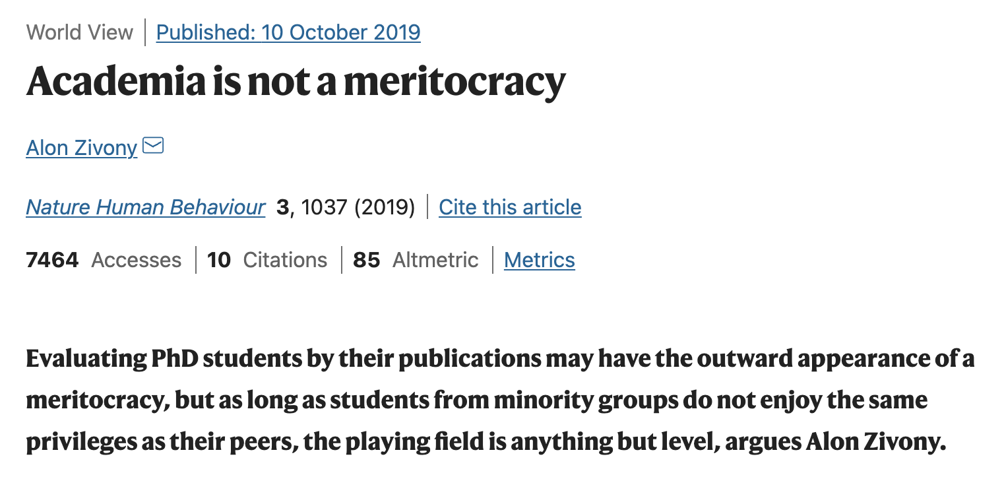

Slide 9
Born in Australia to Malaysian immigrants
First-generation college graduate
Both parents completed secondary education
First-generation PhD
Grew up in a low-income family
First-generation scientist
Both parents were non-English speakers
Postdoctoral researcher (early-career)
Minority ethnicity
International researcher (non-resident alien)
I continue to experience systemic barriers in academia and science
Notes:
Mum Form 3, Dad Form 5. Dad had basic English

Slide 10
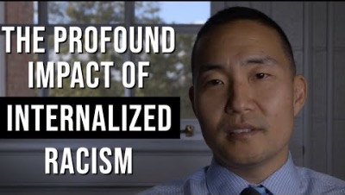
Content warning: suicide
Video titled Dr. Richard Q. Shin: Unlearning internalized racism is a process, uploaded by SPOKENproject. https://www.youtube.com/watch?v=iQzPw-G48aA
Notes:
Content warning: suicide

Slide 11
Not-good-enoughness and lack of support
Am I being taken seriously in science?
Am I perceived as less competent?
Am I being overlooked for opportunities?
Am I systematically undervalued?

Slide 12
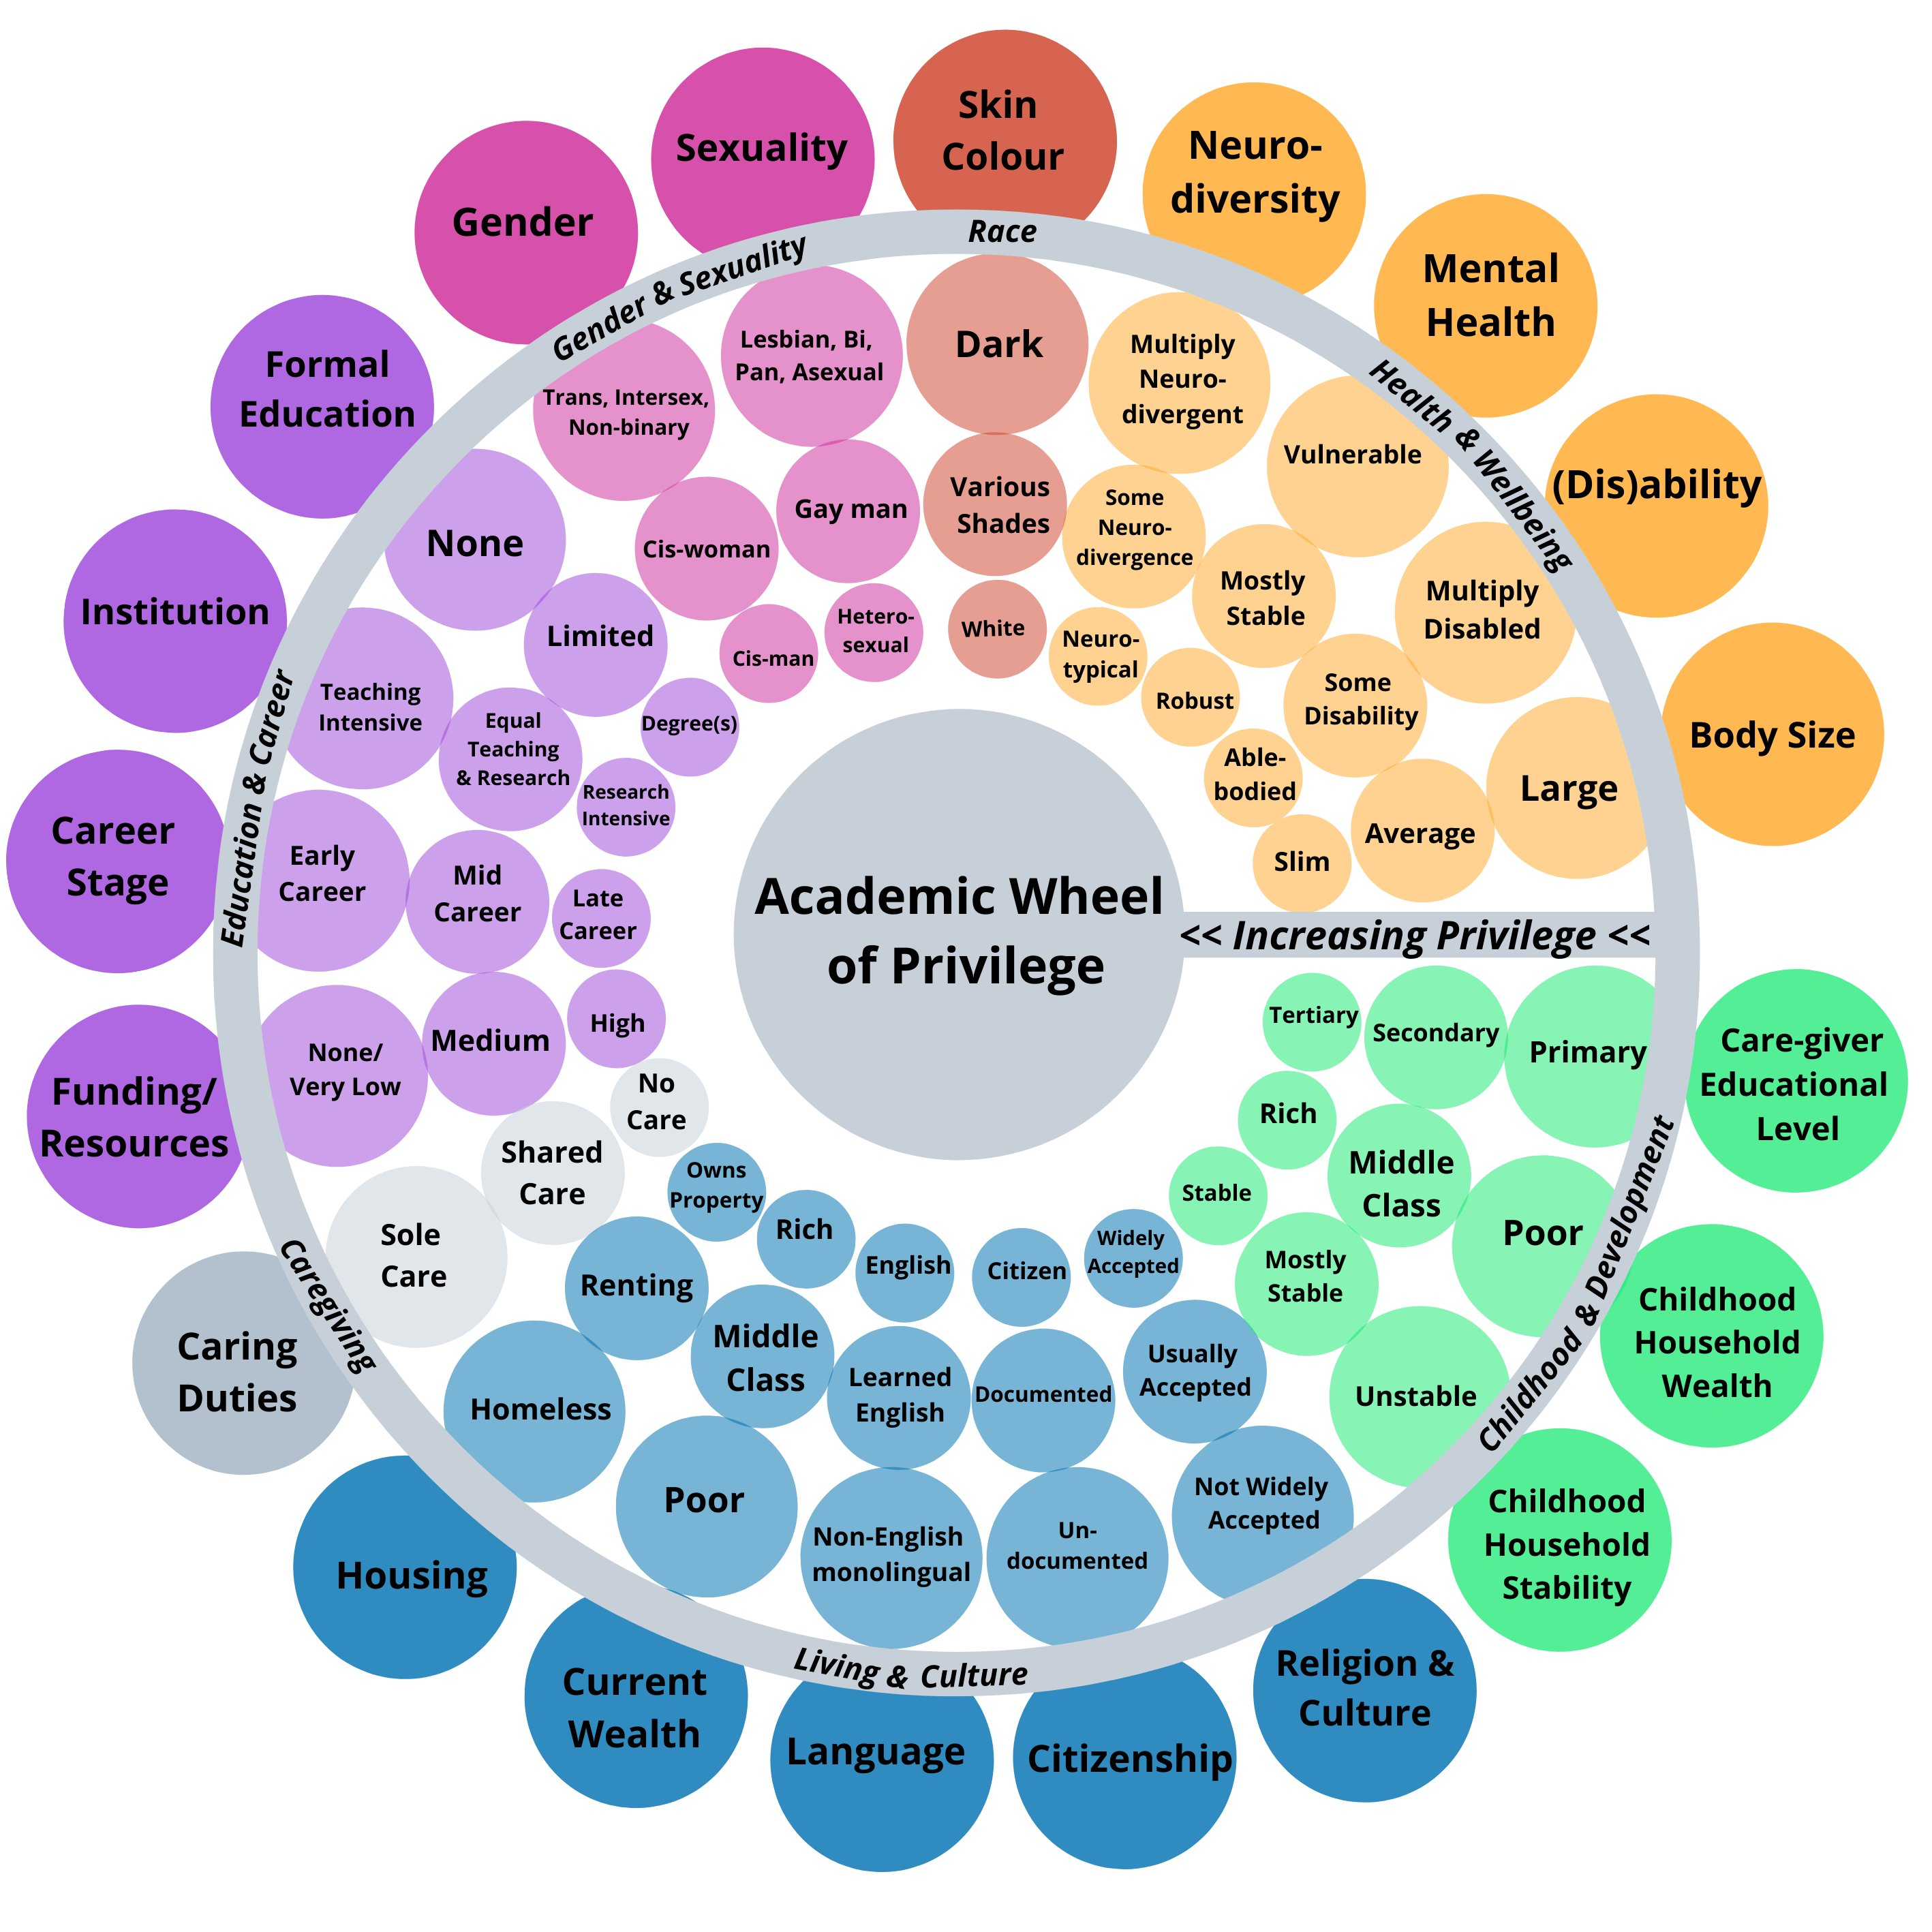
You are told: “Be productive. Aim to publish that high-impact paper, and a lot of them.”
I’m here to tell you: “Academic success is a product of you and your context. And much of the context is broken.”
The goal of science is not to publish papers.
It is to further our understanding of the world.
The Academic Wheel of Privilege by the Framework for Open and Reproducible Research Training (FORRT) Elsherif, M. M., Middleton, S. L., Phan, J. M., Azevedo, F., Iley, B., Grose-Hodge, M., ... & Dokovova, M. (2022). Bridging neurodiversity and open scholarship: How shared values can guide best practices for research integrity, social justice, and principled education. MetaArXiv. June, 20.

Slide 13
The scientific research process
needs to be reformed
Background art by Danielle Navarro https://art.djnavarro.net/gallery/interacting-paths/

Slide 14
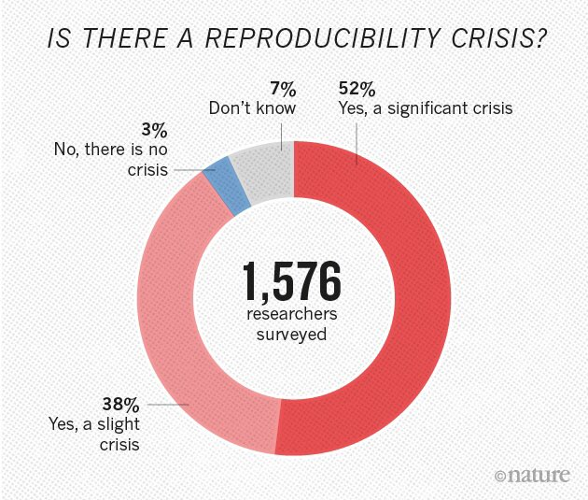
The reproducibility crisis / replication crisis
The recent collective concern that many scientific studies do not replicate
Figure taken from Baker, M. (2016). 1,500 scientists lift the lid on reproducibility. Nature, 533(7604).

Slide 15
In psychology alone:
35 of 97 (36%) positive findings published in high-ranking psychology journals were reproduced in direct replications (Reproducibility Project: Psychology; Open Science Collaboration, 2015)
~48% in JEP:LMC, ~38% in Psychological Science
Mean effect sizes in replications were approximately half of what was reported
13 of 21 (62%) social science experiments published in Nature and Science between 2010 and 2015 successfully replicated (Camerer et al., 2018)
14 of 28 (50%) psychology findings replicated when using massive sample sizes (Many Labs 2; Klein et al., 2018)
3 of 10 (30%) psychology findings replicated across varied participant pools (Many Labs 3; Ebersole et al., 2016)
Open Science Collaboration. (2015). Reproducibility Project: Psychology. OSF. doi:10.17605/OSF.IO/EZCUJ
Klein, R. A., Vianello, M., Hasselman, F., Adams, B. G., Adams Jr, R. B., Alper, S., ... & Batra, R. (2018). Many Labs 2: Investigating variation in replicability across samples and settings. Advances in Methods and Practices in Psychological Science, 1(4), 443-490 Ebersole, C. R., Atherton, O. E., PhD, Belanger, A. L., Skulborstad, H. M., Allen, J., Banks, J. B., … Nosek, B. A. (2016, August 17). Many Labs 3: Evaluating participant pool quality across the academic semester via replication. https://doi.org/10.31234/osf.io/q4emc. Camerer, C. F., Dreber, A., Holzmeister, F., Ho, T. H., Huber, J., Johannesson, M., ... & Wu, H. (2018). Evaluating the replicability of social science experiments in Nature and Science between 2010 and 2015. Nature Human Behaviour, 2(9), 637-644.

Slide 16
Factors resulting in the reproducibility crisis
Insufficient sample sizes / statistical power

Slide 17
Statistical power
The probability of rejecting the null given there is a true effect
p(significant result | true effect)
Also, the inverse probability of making a Type II error (false negative)
But note that this is not the positive predictive value
Statistical power does not equal the p(true effect | significant result)

Slide 18
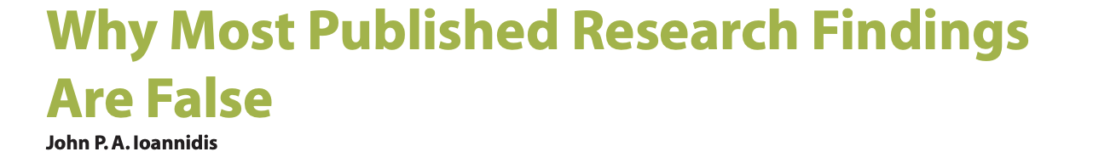
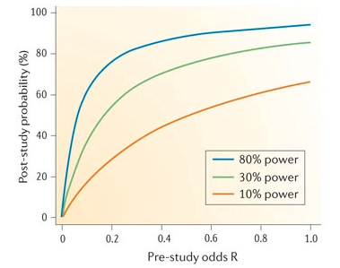
p(true effect | significant result)
Likelihood of a ‘true’ relationship
Figure from Button, K. S., Ioannidis, J. P., Mokrysz, C., Nosek, B. A., Flint, J., Robinson, E. S., & Munafò, M. R. (2013). Power failure: why small sample size undermines the reliability of neuroscience. Nature reviews neuroscience, 14(5), 365-376.

Slide 19
And what has statistical power been?
~24% across science in the past 60 years (Smaldino & McElreath, 2016)
~8-31% across neuroscience disciplines (Button et al., 2013)
~36% across all areas of psychological research (Stanley, Carter & Doucouliagos, 2018)
~44% for medium sized effects in psychology and cognitive neuroscience literature (Szucs & Ioannidis, 2017)
Smaldino, P. E., & McElreath, R. (2016). The natural selection of bad science. Royal Society open science, 3(9), 160384.
Button, K. S., Ioannidis, J. P., Mokrysz, C., Nosek, B. A., Flint, J., Robinson, E. S., & Munafò, M. R. (2013). Power failure: why small sample size undermines the reliability of neuroscience. Nature reviews neuroscience, 14(5), 365-376.
Stanley, T. D., Carter, E. C., & Doucouliagos, H. (2018). What meta-analyses reveal about the replicability of psychological research. Psychological bulletin, 144(12), 1325.
Szucs, D., & Ioannidis, J. P. (2017). Empirical assessment of published effect sizes and power in the recent cognitive neuroscience and psychology literature. PLoS biology, 15(3), e2000797.

Slide 20
Factors resulting in the reproducibility crisis
Insufficient sample sizes / statistical power
Questionable research practices / Fraud

Slide 21
Bem (2011): Feeling the Future
Bem, a well-known and respected social psychologist and professor at the time, publishes positive evidence for precognition and premonition
9 experiments, 1000 participants
Standard statistical analyses
Published in the Journal of Personality and Social Psychology (a highly prestigious journal!) after peer review!
A pre-registered replication failed to find any of the reported effects in three attempts (Ritchie, Wiseman and French, 2012)
Rejected at the JPSP
Rejected at the British Journal of Psychology supposedly where Bem was a reviewer!
Bem, D. J. (2011). Feeling the future: experimental evidence for anomalous retroactive influences on cognition and affect. Journal of personality and social psychology, 100(3), 407.
Ritchie, S. J., Wiseman, R., & French, C. C. (2012). Failing the future: Three unsuccessful attempts to replicate Bem's ‘Retroactive Facilitation of Recall’ Effect. PloS one, 7(3).
https://www.theguardian.com/science/2012/mar/15/precognition-studies-curse-failed-replications

Slide 22
p-hacking
Simmons, Nelson and Simonsohn (2011) found ‘evidence’ that listening to music caused people to become younger!
An ANCOVA revealed people were nearly a year-and-a-half younger after listening to “When I’m Sixty-Four” rather than to “Kalimba”, F(1,17) = 4.92, p = .040.
Highlighted the issue of researcher degrees of freedom and questionable research practices (QRPs)
Simmons, J. P., Nelson, L. D., & Simonsohn, U. (2011). False-positive psychology: Undisclosed flexibility in data collection and analysis allows presenting anything as significant. Psychological science, 22(11), 1359-1366.

Slide 23
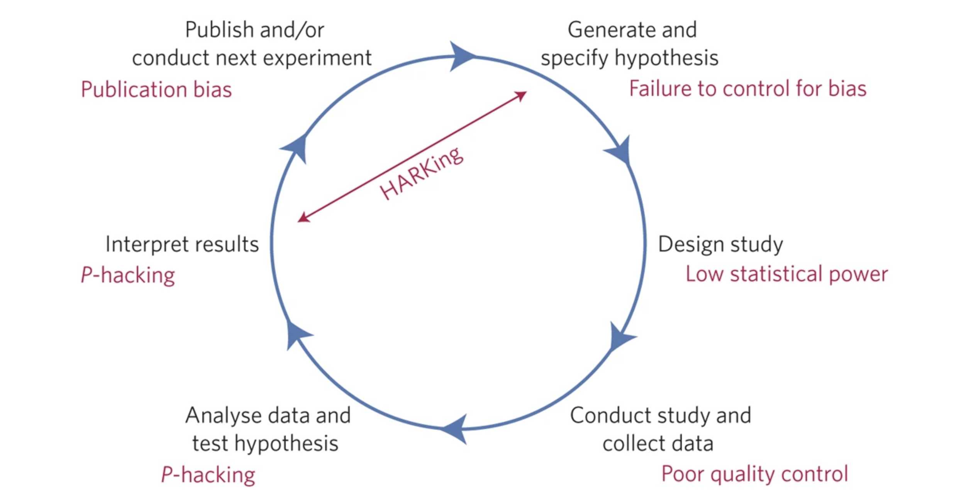
Threats to reproducible science
Munafò, M. R., Nosek, B. A., Bishop, D. V., Button, K. S., Chambers, C. D., Du Sert, N. P., ... & Ioannidis, J. P. (2017). A manifesto for reproducible science. Nature human behaviour, 1(1), 1-9.

Slide 24
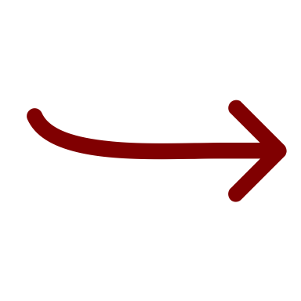
How prevalent are questionable research practices?
Most of these may be unintentional – the researcher didn’t know any better
But…
John, L. K., Loewenstein, G., & Prelec, D. (2012). Measuring the prevalence of questionable research practices with incentives for truth telling. Psychological science, 23(5), 524-532.

Slide 25
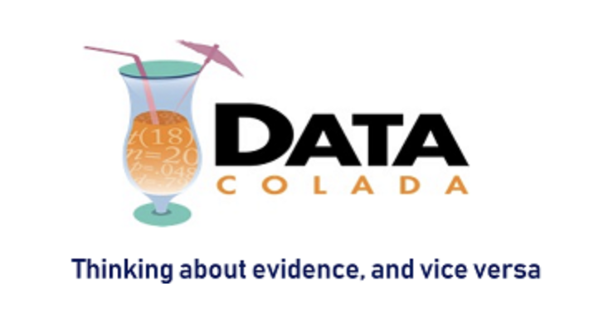
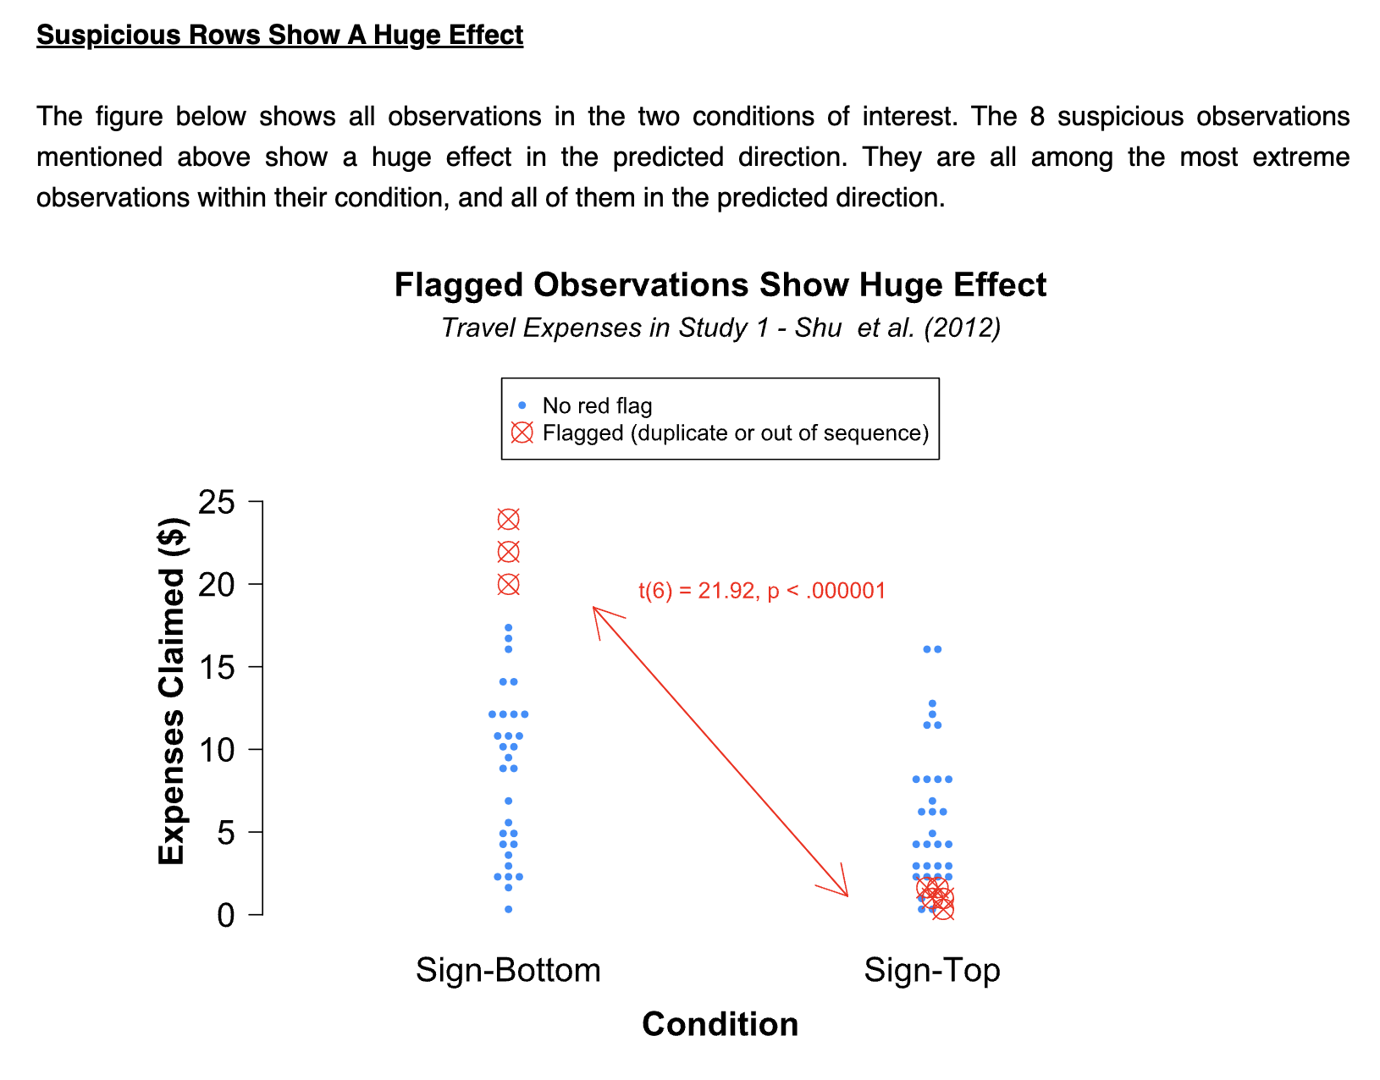
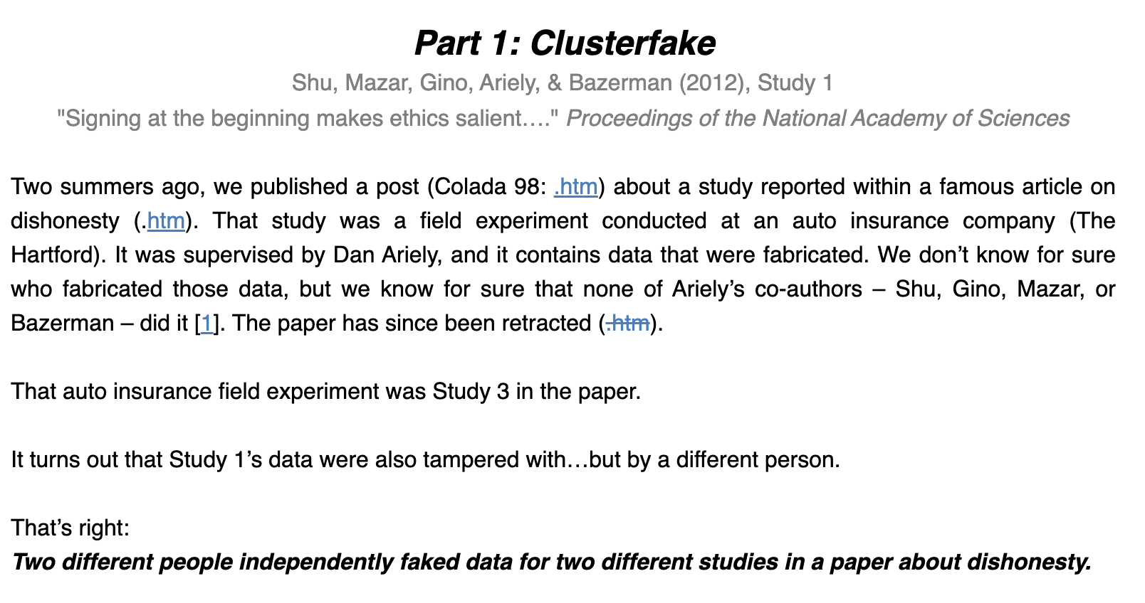
Simmons, Nelson and Simohnsohn from earlier!
https://datacolada.org/109

Slide 26
Factors resulting in the reproducibility crisis
Insufficient sample sizes / statistical power
Questionable research practices / Fraud
Academic capitalism / publication bias

Slide 27
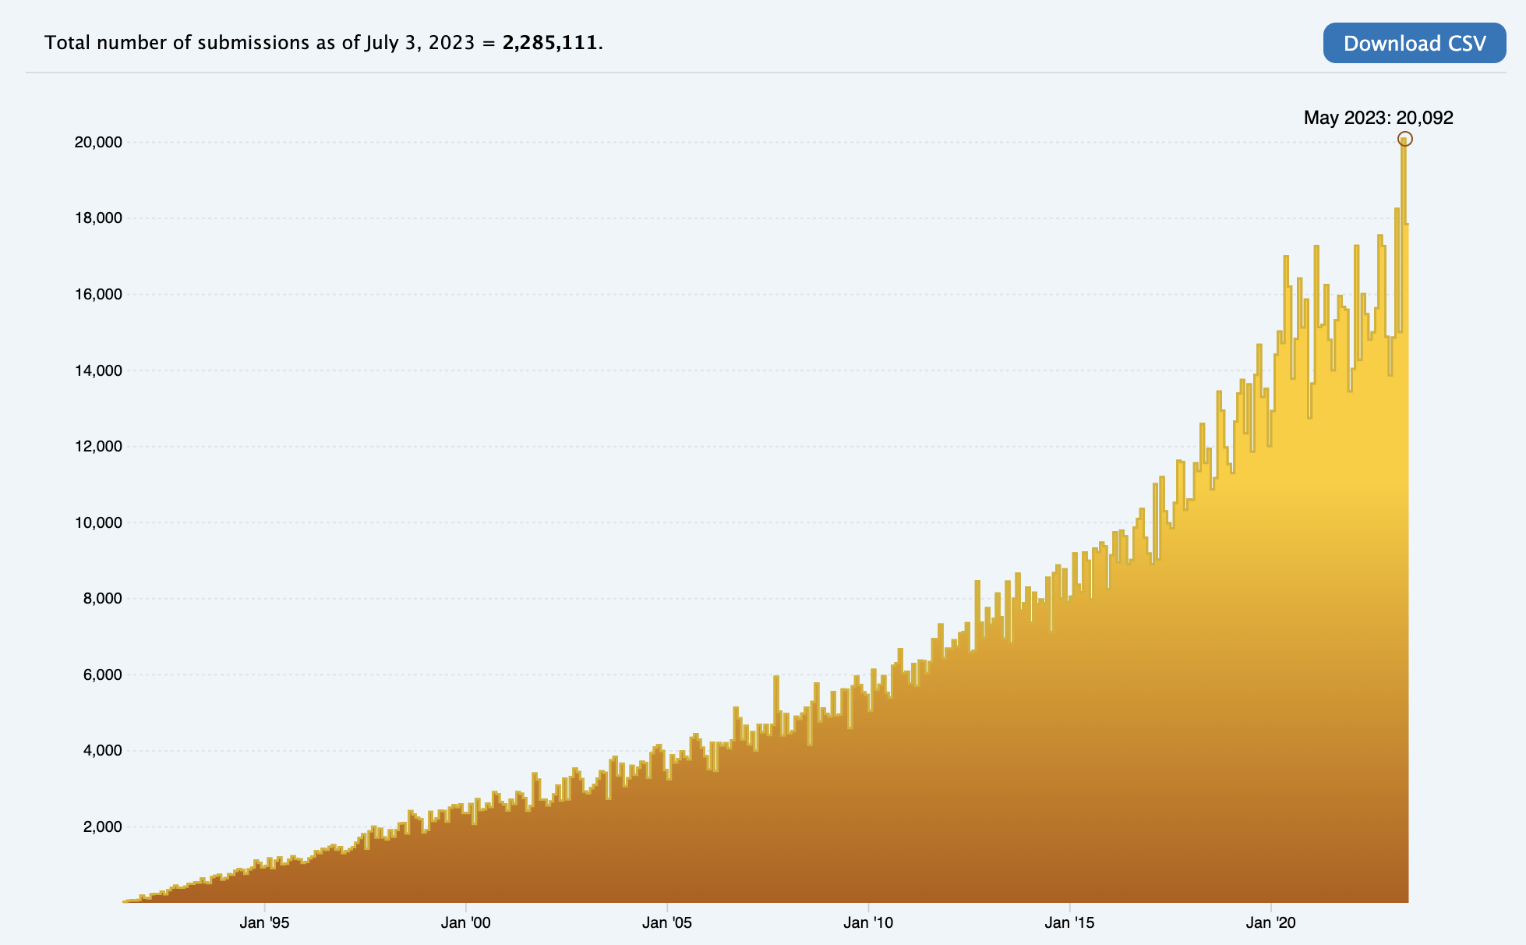
Exponential growth of scientific publications
Figure taken from arxiv.org on the number of submissions over time. https://arxiv.org/stats/monthly_submissions

Slide 28
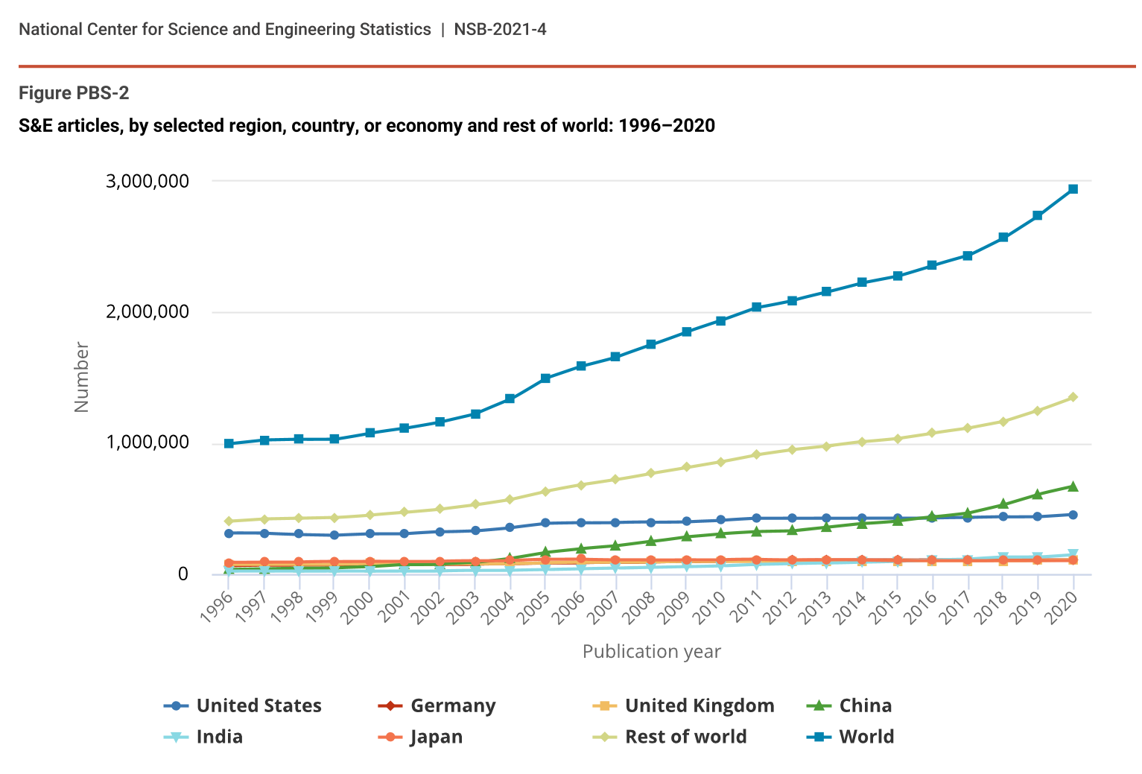
Exponential growth of scientific publications
Estimated to have reached 2.9 million articles in 2020 (National Science Board, National Science Foundation)
Increasing by approximately 4% each year (Pan, Petersen, Pammolli and Fortunato, 2016)
Review by National Center for Science and Engineering Statistics. https://ncses.nsf.gov/pubs/nsb20214/publication-output-by-country-region-or-economy-and-scientific-field
Pan, R. K., Petersen, A. M., Pammolli, F., & Fortunato, S. (2018). The memory of science: Inflation, myopia, and the knowledge network. Journal of Informetrics, 12(3), 656-678. https://arxiv.org/abs/1607.05606

Slide 29
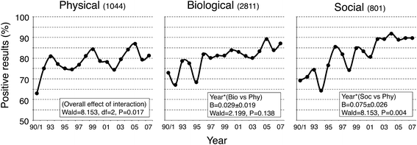
The decline of negative results
The proportion of papers reporting a positive result has been increasing from ~70% in 1990 to ~90% by 2005 (Fanelli, 2012)
In the recent psychology literature, this proportion is estimated to be ~95% (Scheel, Schijen and Lakens, 2021)
Does more papers (mostly with positive findings) mean faster scientific progress?
I say not really.
Figure from Fanelli, D. (2012). Negative results are disappearing from most disciplines and countries. Scientometrics, 90(3), 891-904. Scheel, A. M., Schijen, M. R., & Lakens, D. (2021). An excess of positive results: Comparing the standard Psychology literature with Registered Reports. Advances in Methods and Practices in Psychological Science, 4(2), 25152459211007467.

Slide 30
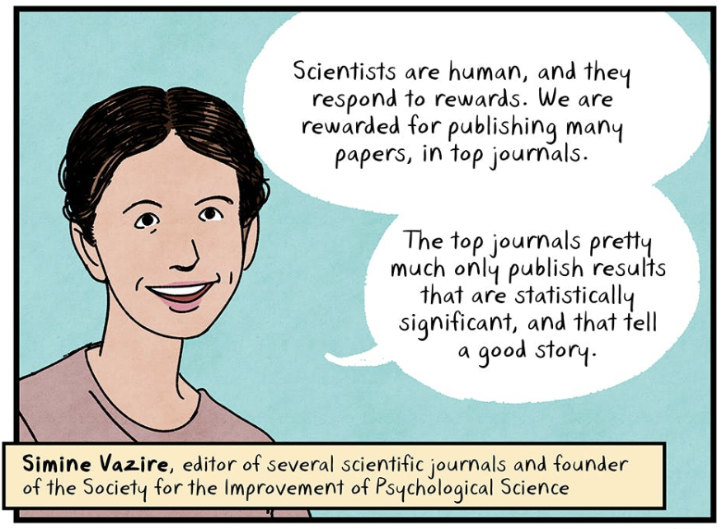
Capitalist academic structures have lead to more papers, but with incentives and research assessment being broken, it has not meant more rigorous science.
Taken from Repeat After Me by Maki Naro. Published by The Nib. https://thenib.com/repeat-after-me/

Slide 31
Factors resulting in the reproducibility crisis
Insufficient sample sizes / statistical power
Questionable research practices / Fraud
Academic capitalism / publication bias
Lack of replications

Slide 32
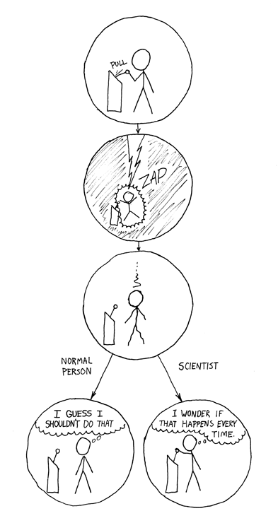
Comic from https://xkcd.com/242/

Slide 33
How often do direct replications occur in psychology?
0.2%
(169 out of 82,775 articles)
Figure given by Beth Clarke in a talk titled “The prevalence of replications in psychology”, given at the Metascience 2023 conference. https://www.youtube.com/watch?v=teOvjoJbmvM

Slide 34
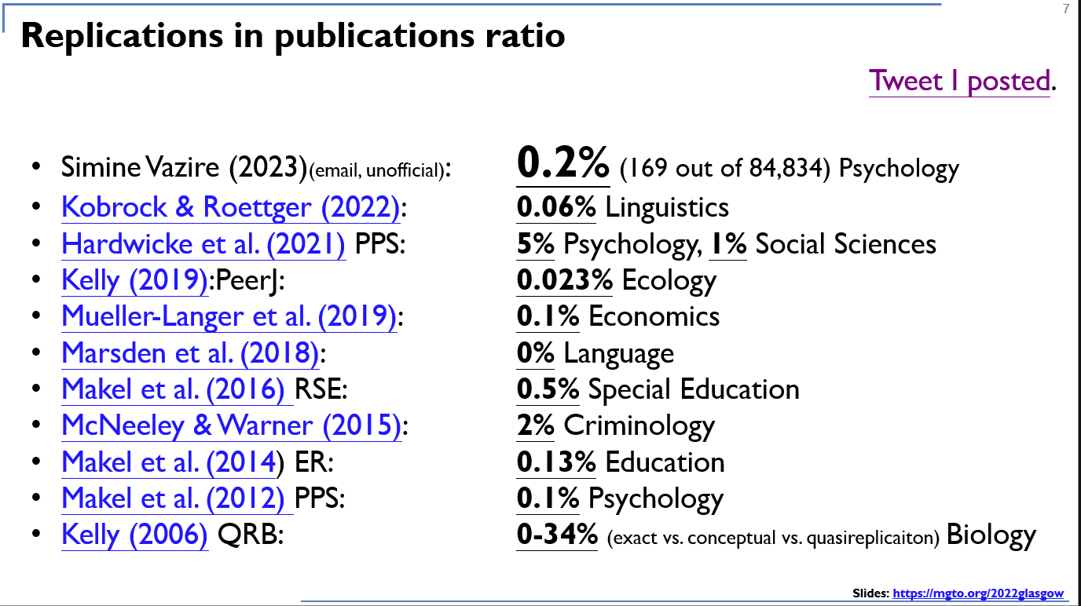
Not enough.
Slide by Gilad Feldman. Taken from https://twitter.com/giladfeldman/status/1662887769822068738/photo/1

Slide 35
Factors resulting in the reproducibility crisis
Insufficient sample sizes / statistical power
Questionable research practices / Fraud
Academic capitalism / publication bias
Lack of direct replications
Soft theories / over-reliance on NHST

Slide 36
Playing 20 questions with nature
It is often assumed that…
Theory A
Theory B
Result A
Result B
Newell, A. (1973). You can't play 20 questions with nature and win: Projective comments on the papers of this symposium.

Slide 37


Playing 20 questions with nature
Assumes a fundamental dichotomy between theories
It is often assumed that…
Theory A
Theory B
Result A
Result B
Does not allow for indefinite conclusions or evidence for the null
Newell, A. (1973). You can't play 20 questions with nature and win: Projective comments on the papers of this symposium.

Slide 38

Playing 20 questions with nature
The reality is more like…
Theory A
Theory B
All empirical results
Newell, A. (1973). You can't play 20 questions with nature and win: Projective comments on the papers of this symposium.

Slide 39

Playing 20 questions with nature
Under-specified theories/models
The reality is more like…
Theory A
Theory B
Under-determined experiments
Fixation with significant results
All empirical results
Newell, A. (1973). You can't play 20 questions with nature and win: Projective comments on the papers of this symposium.

Slide 40
A theory crisis in psychological science
An understated precursor to the reproducibility crisis may be the lack of coordinated theoretical development
An over-reliance on the hypothetico-deductive method (e.g. null hypothesis significance testing) for inferences
Questionable research practices (QRPs): p-hacking, HARKing, data manipulation, etc.
Under-specified theories with under-determined experimental designs
Ad hoc changes in models, straw-man of competing models, blunt instruments of measurement
Overgeneralization of a theory or model to all related phenomena or empirical conditions
A lack of intellectual humility…
Borsboom D. (2013, November 20). Theoretical amnesia. Center for Open Science Borsboom, D., van der Maas, H. L., Dalege, J., Kievit, R. A., & Haig, B. D. (2021). Theory construction methodology: A practical framework for building theories in psychology. Perspectives on Psychological Science, 16(4), 756-766. Oberauer K., Lewandowsky S. (2019). Addressing the theory crisis in psychology. Psychonomic Bulletin & Review, 26, 1596–1618. Maatman, F. O. (2021). Psychology's theory crisis, and why formal modelling cannot solve it. PsyArXiv Meehl P. E. (1978). Theoretical risks and tabular asterisks: Sir Karl, Sir Ronald, and the slow progress of soft psychology. Journal of Consulting and Clinical Psychology, 46, 806–834.
Meehl, P. E. (1967). Theory-testing in psychology and physics: A methodological paradox. Philosophy of science, 34(2), 103-115.

Slide 41
Factors resulting in the reproducibility crisis
Insufficient sample sizes / statistical power
Questionable research practices / Fraud
Academic capitalism / publication bias
Lack of direct replications
Soft theories / over-reliance on NHST
No development of research assessment

Slide 42
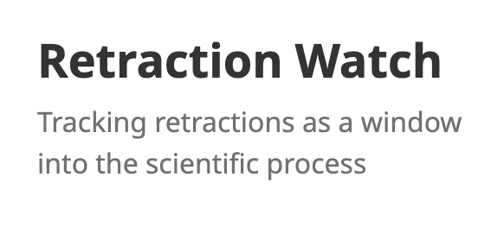
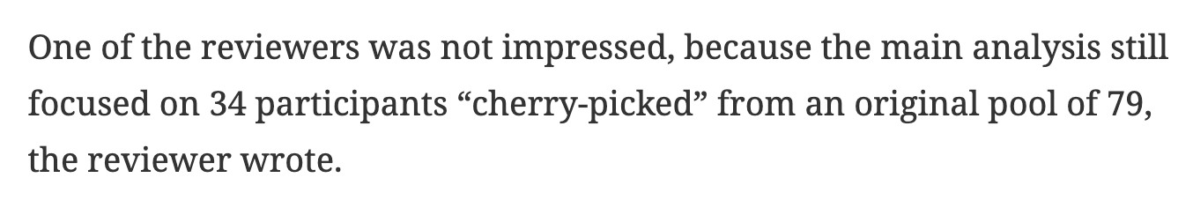
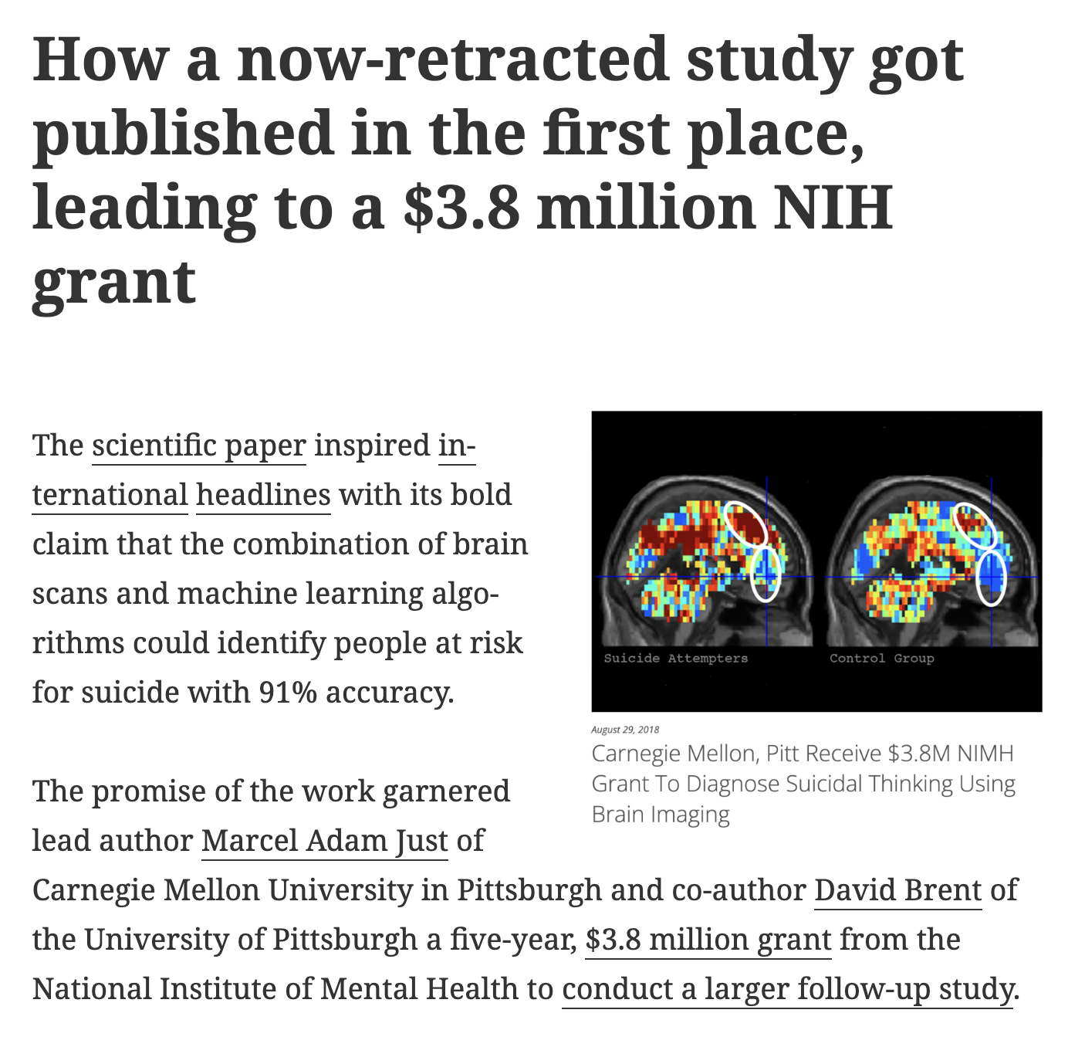
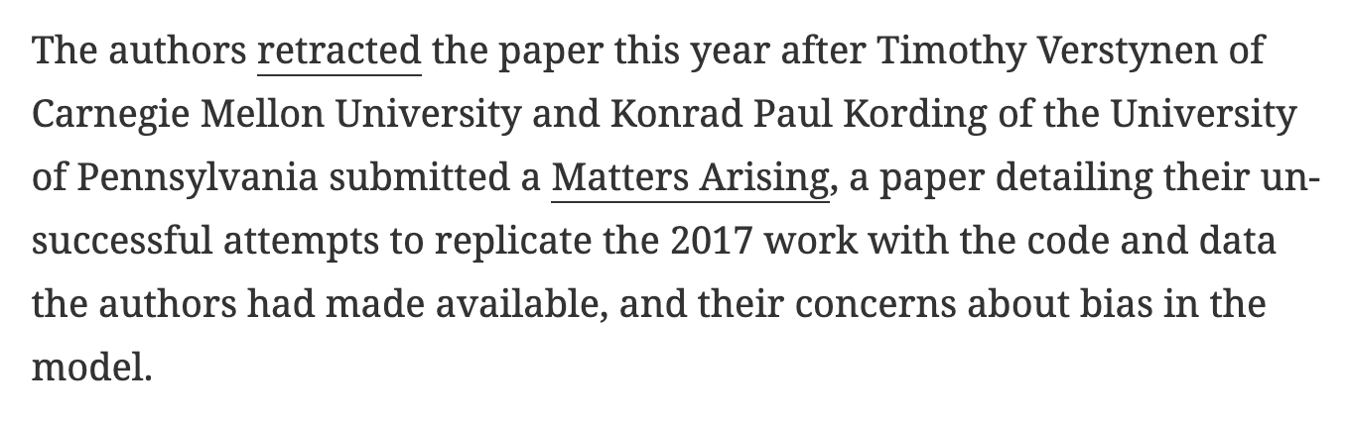
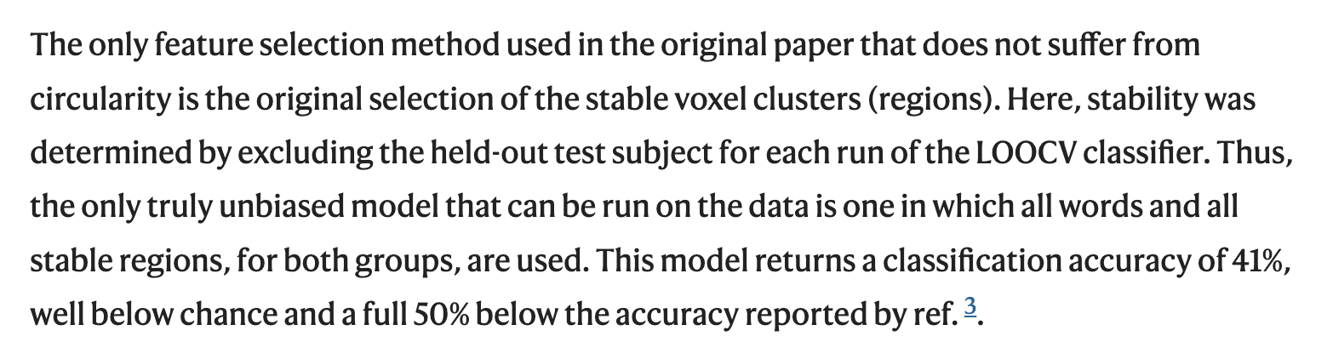
This was received by Nature in 2020, only published on 6th April, 2023.
https://retractionwatch.com/2023/06/09/how-a-now-retracted-study-got-published-in-the-first-place-leading-to-a-3-8-million-nih-grant/ Verstynen, T., & Kording, K. P. (2023). Overfitting to ‘predict’suicidal ideation. Nature Human Behaviour, 7(5), 680-681.

Slide 43
Factors resulting in the reproducibility crisis
Insufficient sample sizes / statistical power
Questionable research practices / Fraud
For-profit $cientific journals
Academic capitalism / publication bias
Lack of direct replications
Unsustainable academic labor structures
Soft theories / over-reliance on NHST
Tired science pedagogy
No development of research assessment

Slide 44
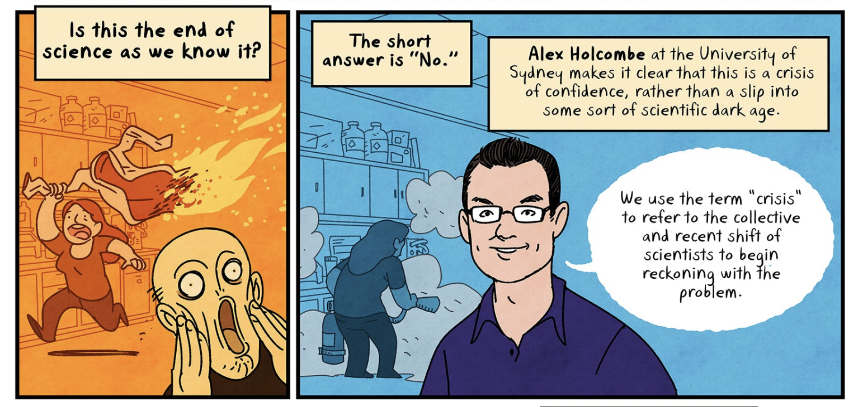
Taken from Repeat After Me by Maki Naro. Published by The Nib. https://thenib.com/repeat-after-me/

Slide 45
How do we reform science and academia?
Background art by Danielle Navarro https://art.djnavarro.net/gallery/interacting-paths/

Slide 46
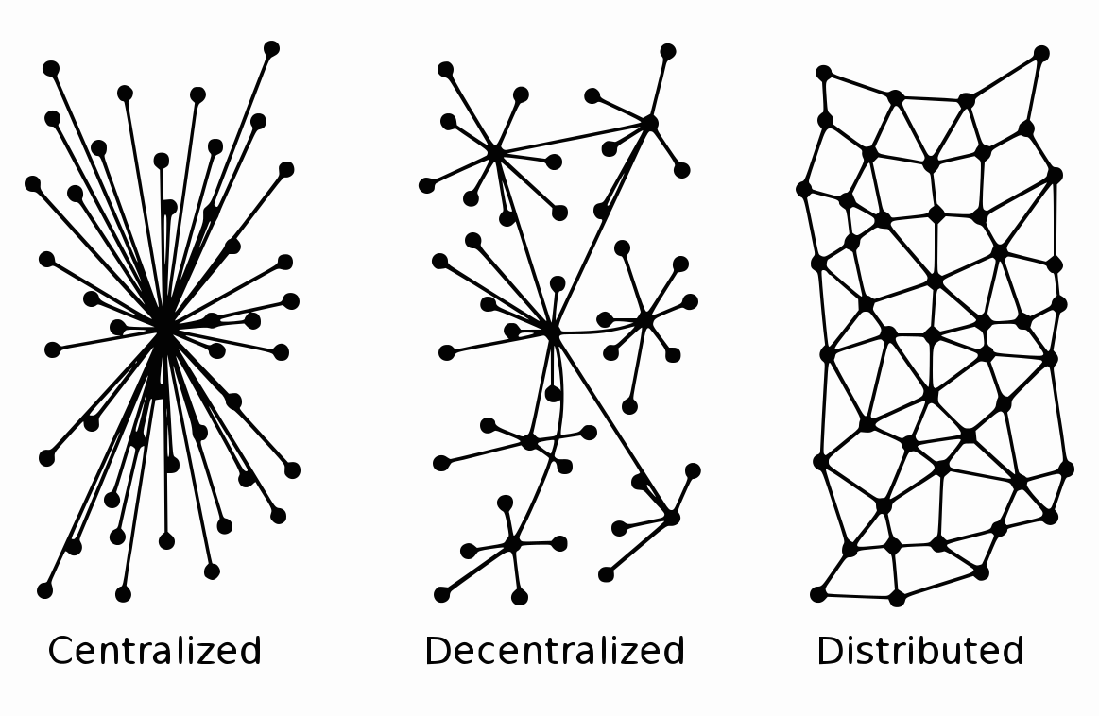
Positive change has to occur across many levels, from many sources.
This won’t work.

Slide 47
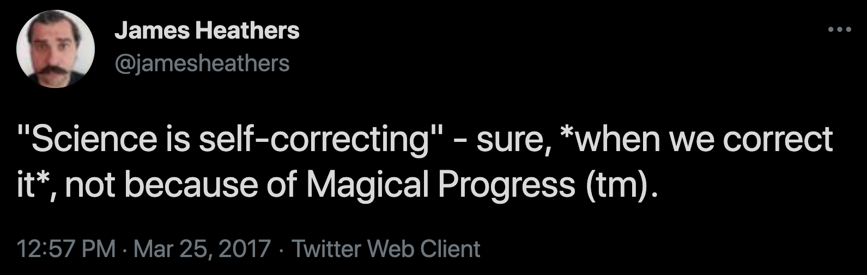
Not doing anything adds resistance to changes and reforms

Slide 48
This hasn’t worked.
e.g. I’ve seen little support from this department in the past 4 years.
This could work…
But reform is siloed, and would not spread across the network.
This is best.
We need reform at many levels, and changes to spread through the network.

Slide 49
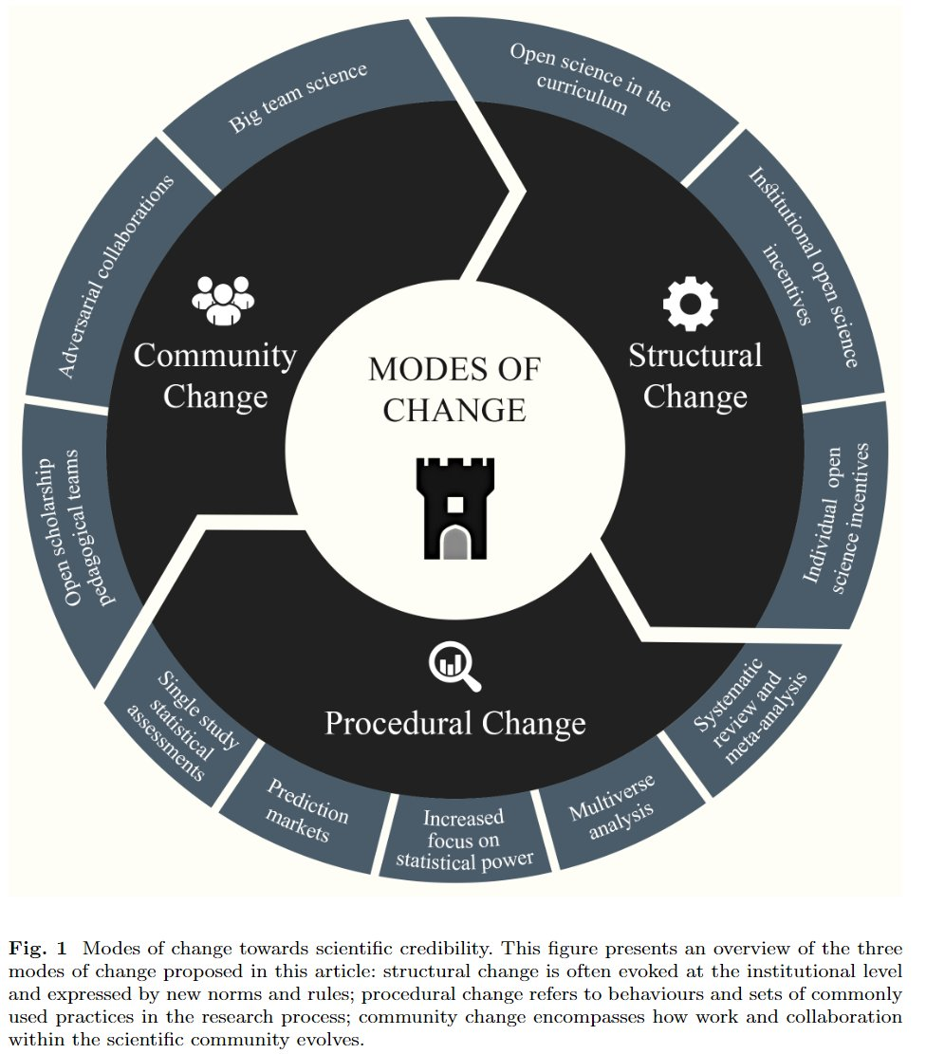

It is my firm belief that the next generation of researchers will change science for the better
Korbmacher, M., Azevedo, F., Pennington, C., Hartmann, H., Pownall, M., Schmidt, K., ... & Evans, T. (2023). The replication crisis has led to positive structural, procedural, and community changes. Communications Psychology.

Slide 50
Science is better when it is open and transparent
Background art by Danielle Navarro https://art.djnavarro.net/gallery/interacting-paths/

Slide 51
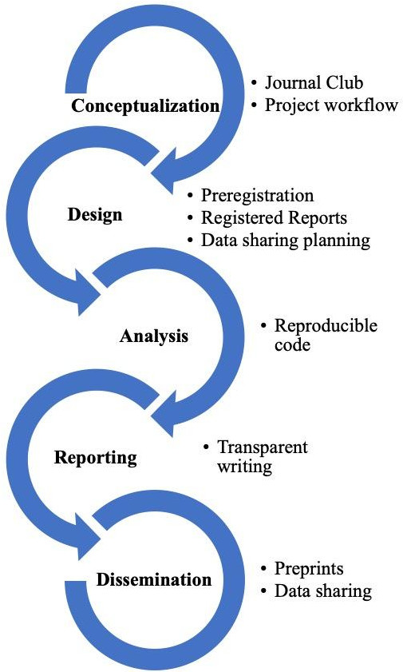
Where do I start?
Open Science is not “all or nothing”
These are research skills that take time to develop!
Some easy Open Science practices to adopt:
Post free copies of published articles / deposit preprints of all manuscripts
Publish in open access venues
Publicly share data and materials
Preregister studies
Kathawalla, U. K., Silverstein, P., & Syed, M. (2021). Easing into open science: A guide for graduate students and their advisors. Collabra: Psychology, 7(1).
McKiernan, E. C., Bourne, P. E., Brown, C. T., Buck, S., Kenall, A., Lin, J., ... & Yarkoni, T. (2016). Point of view: How open science helps researchers succeed. eLife, 5, e16800.

Slide 52
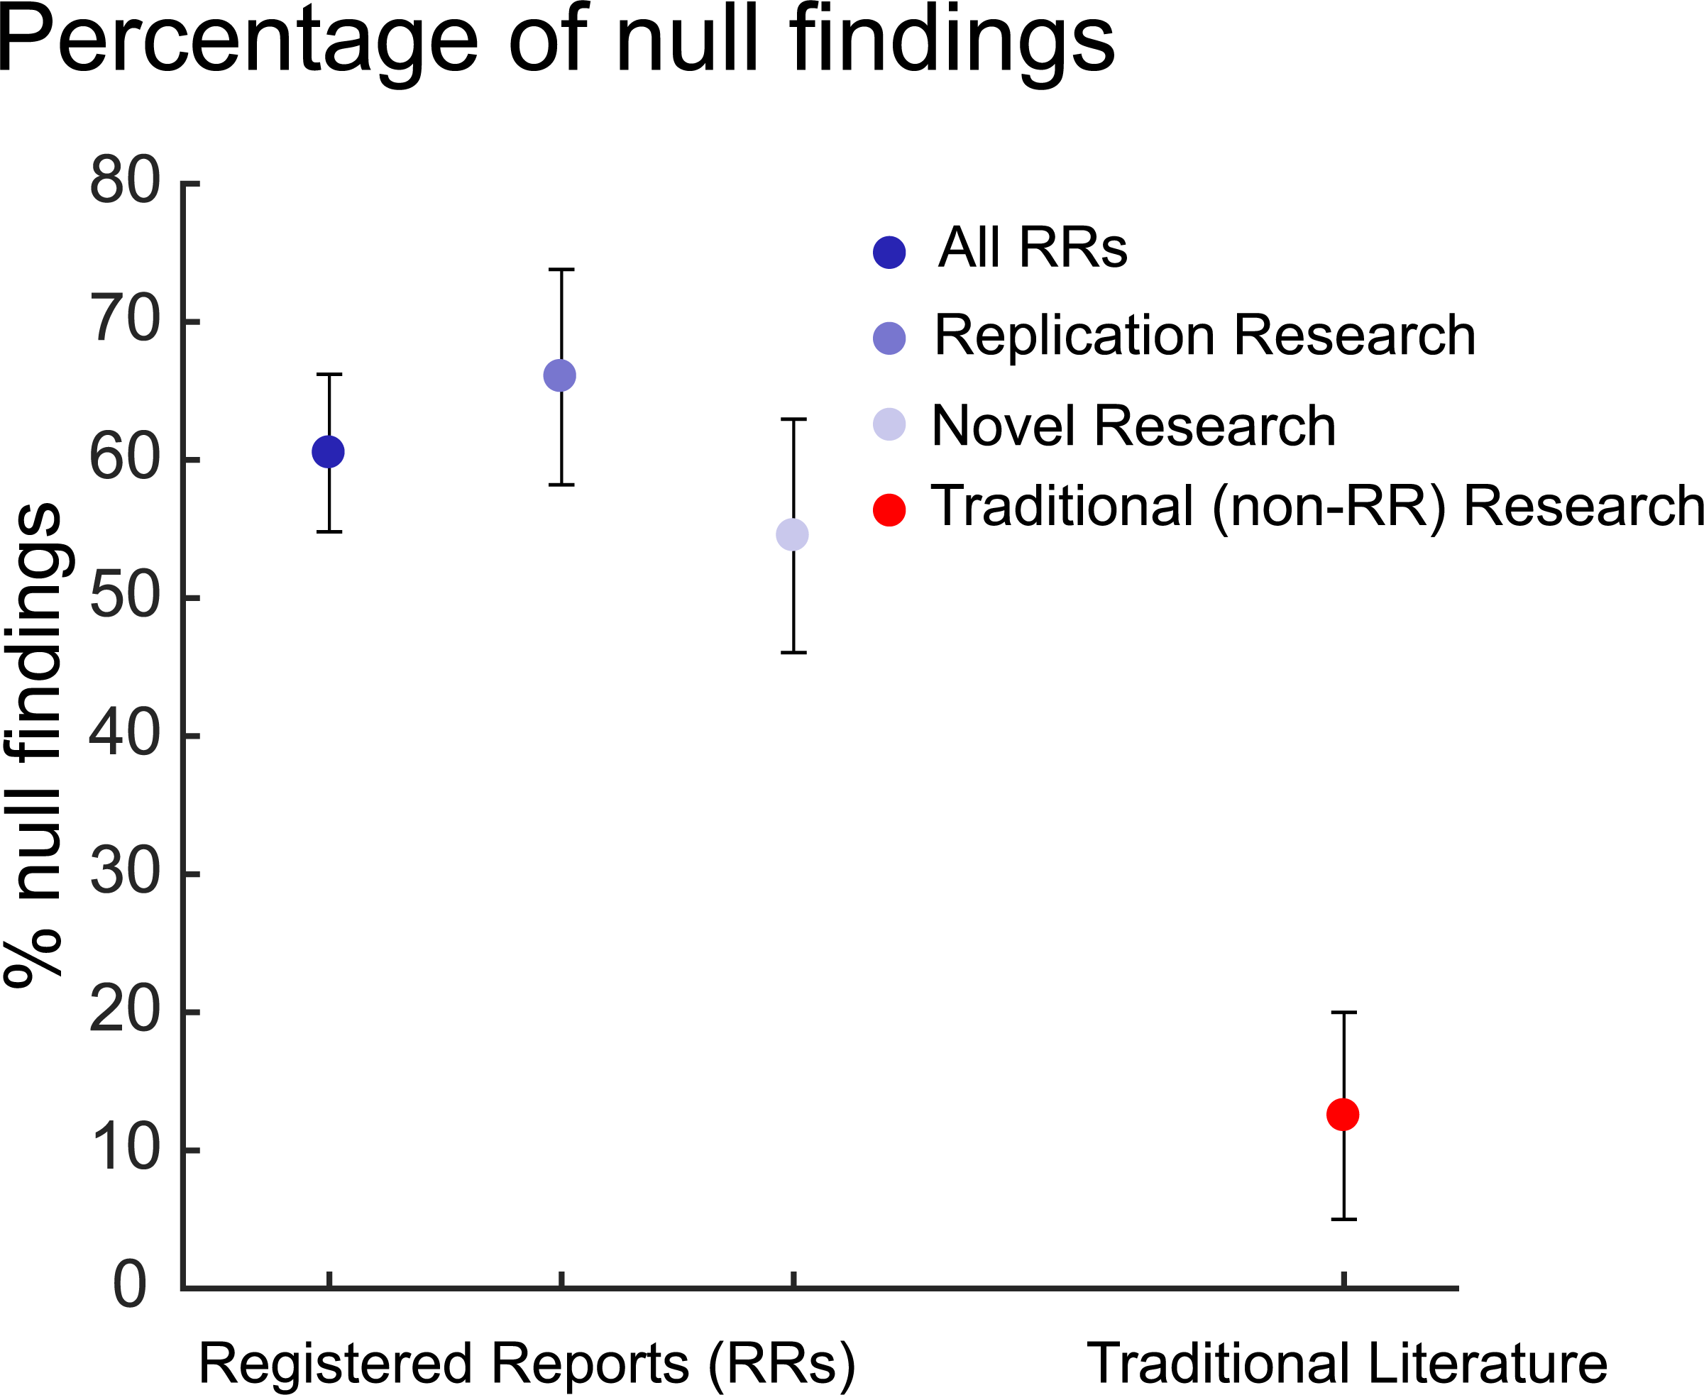
Allen, C., & Mehler, D. M. (2019). Open science challenges, benefits and tips in early career and beyond. PLoS biology, 17(5), e3000246.

Slide 53
Personal benefits of Open Science
May improve the quality and reliability of your scientific research
For example, preregistrations prompt theory development, justifications of sample sizes and analyses, and statistical power considerations to protect against researcher bias
Increases the impact of your scientific research
Increase reviewers’ quality of feedback if they reproduce your results and analyses
Increase citations from re-analysis and re-use of open datasets
Can become part of your academic brand
Increasingly considered in grants and job applications
Markowetz, F. (2015). Five selfish reasons to work reproducibly. Genome biology, 16(1), 1-4. Piwowar, H. A., & Vision, T. J. (2013). Data reuse and the open data citation advantage. PeerJ, 1, e175.

Slide 54
This seems like a lot more work…
What is your goal in science?
Do you want to be beholden to the Incentives?
Or do you want to pave the way towards better understanding?
Rigorous and careful science does take some more effort and time
Saves time
Easier to revisit past experiments in-between review rounds or even years later!
Creating reproducible workflows to implement in future research projects
Reduces research waste
Can help catch mistakes like errors in experimental and analysis code
Better thought-out experiments may mean smooth peer reviews (rather than requests for additional experiments)
Being an advocate for Open Science means pushing for reform to research assessment and labor structures in academia
Yarkoni, T. (2018). It’s not the Incentives, it’s you. https://www.talyarkoni.org/blog/2018/10/02/no-its-not-the-incentives-its-you/
Hostler, T. (2023). The Invisible Workload of Open Research. Journal of Trial and Error

Slide 55
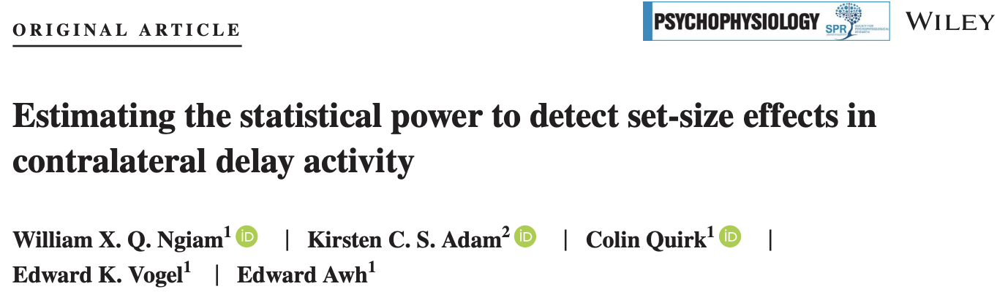
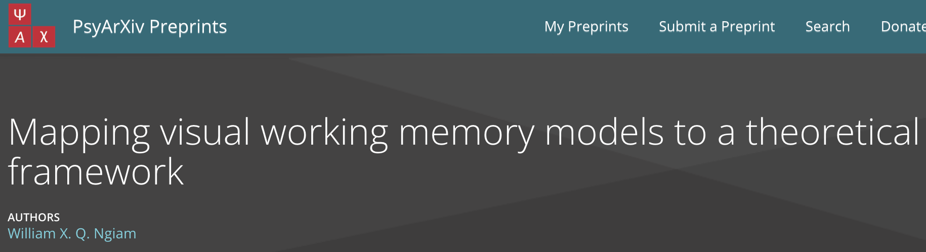
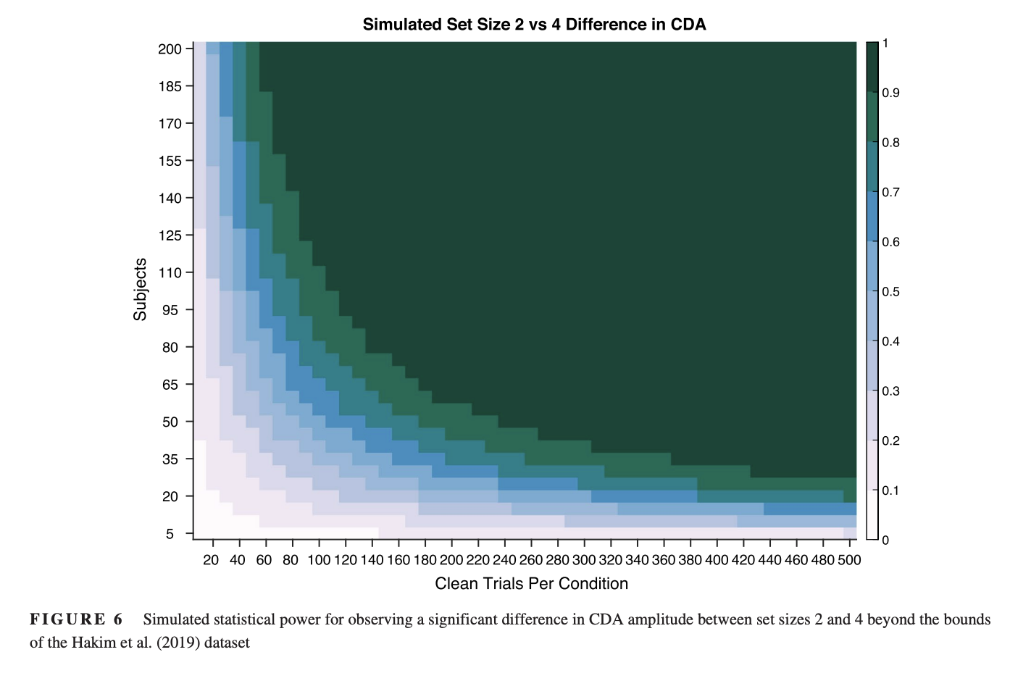
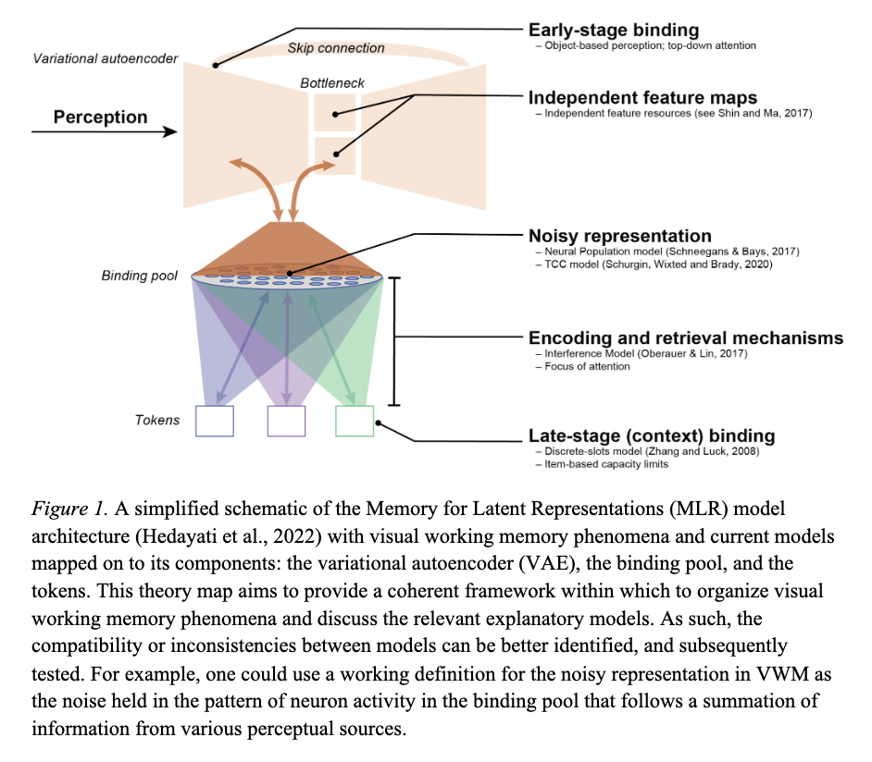
It’s not either/or – your goals can include improving science while conducting empirical research.

Slide 56


On my website, under “reading lists”

Slide 57
You don’t have to do this on your own
Only one hour or so out of your week
Form community with your fellow junior scientists from otherwise siloed areas in the department
Develop and get advice on your research and science
Have the hidden curriculum of academia and science revealed

Slide 58

Takeaways
The goal of science isn’t to publish papers but to further our understanding of the world
Academia is not a meritocracy – there exist many inequities in the system
Scientific research needs to be fixed – by prioritizing replications, rigor, and transparency
Early-career researchers should act to change the broken system they are inheriting
There are many benefits to engaging in Open Science, and the best time to start is now
hopefully…
Dr William Xiang Quan Ngiam
Slides: https://williamngiam.github.io/files

